Slide 1
VASCULAR ACCESS CHALLENGES A CASE REPORT
DR.G.SELVARANI,MD.DM
PROFESSOR OF CARDIOLOGY
MADURAI MEDICAL COLLEGE,MADURAI,
TAMIL NADU
mail id: selvarani_40@yahoo.com
ph no: 9443471956

Slide 2
BACKGROUND
57 YEARS MALE SMOKER/ALCOHOLIC
H/O CAD/IWMI THROMBOLYSED AT LOCAL HOSPITAL 2 WEEKS BEFORE ADMISSION
KNOWN SHT/CKD HBS AG+VE
TYPE B STAND FORD AORTIC DISSECTION SINCE 1 YEAR.
O/E
PULSE 80/MIN EQUAL
BP 160/80 MMHG
CVS S1S2 HEARD
NO MURMUR

Slide 3
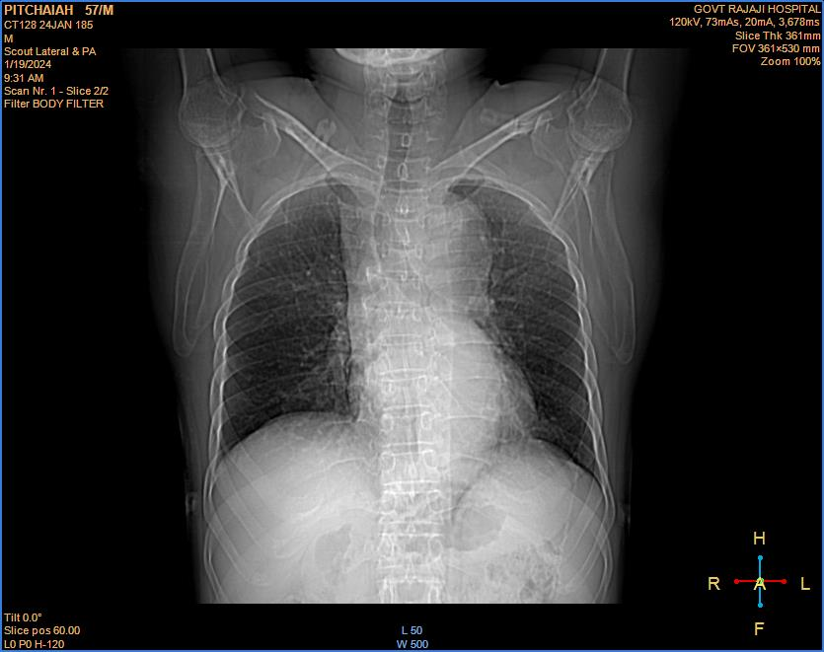
INVESTIGATIONS ECHO
TC 6.6X10³/UL
HB 11.8 G/DL
UREA 36MG%
CREATINE 1.5MG%
PLATELET 330 X 10³/UL
HYPO IPW
EF 57%
AORTIC DISSECTION SEEN IN DESCENDING THORACIC AORTA

Slide 4
ECG

Slide 5
MR AORTOGRAM

Slide 6
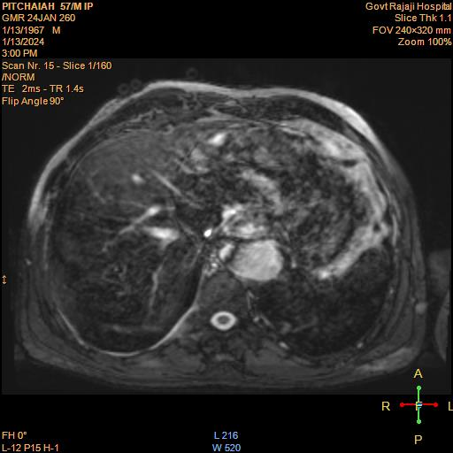
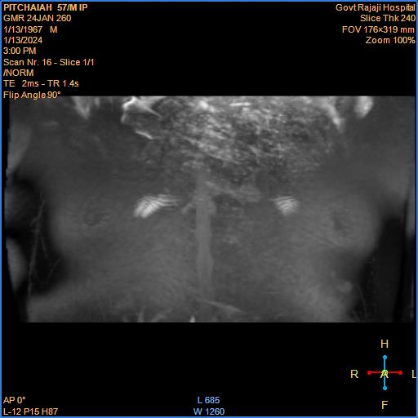

Slide 7
ANGIOGRAM RRA ONLY SAFE ACCESS

Slide 9
PCI RRA ACCESS SPASM

Slide 10
FINALLY BRACHIAL ARTERY ACCESS

Slide 11
2.75 X36 DES

Slide 13
TAKE HOME MESSAGE
VASCULAR ACCESS MAY NOT BE AVAILABLE IN CERTAIN CASES LIKE PAOD,TAKAYASU ARTERITIS
AORTIC DISSECTION PRECLUDES THE FEMORAL ACCESS. ONE ACCESS ONLY CASES MAY POSE DIFFICULTIES TO THE OPERATOR
RISK OF VASCULAR ACCESS COMPLICATIONS TO BE KEPT IN MIND IN SUCH CASES
RADIAL ACCESS SPASM MAY BE A CHALLENGING PROBLEM SOMETIMES IN VAIN
BRACHIAL ARTERY ACCESS SHOULD NOT BE TAKEN AS A ROUTINE VASCULAR ACCESS

