Slide 1
Lm bifurcation stenting
1
PRESENTER:Dr Spandana
(MD.DM,CARDIOLOGY)
KIMS SAVEERA HOSPITAL
ANANTAPUR

Slide 2
Clinical details
2
43 years Male
Not DM
NO HTn
Current Chronic smoker
H/o exertional angina since I Month
Post PTCA to LAD (2017)
Post PTCA to 1 DES to proximal LCX + 1 DES LMCA to LCX in 21-06-2023
On Ecosprin and ticagrelor
EF 40%
RWMA IN LAD TERRITORY
Mild MR

Slide 3
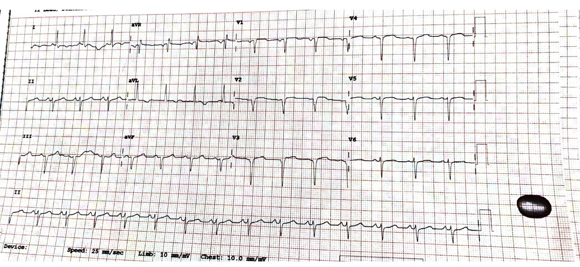
Ecg at presentation
3

Slide 4
4
CAG

Slide 5
05
Not Willing for CABG
Management strategies?
CULLOTTE TECHNIQUE
TAP TECHNIQUE
DK CULLOTTE TECHNIQUE
DEB TO PROXIMAL LAD(NOT PREFARABLE IN OSTIAL LAD).

Slide 6
Wiring and pre dilatation
06

Slide 7
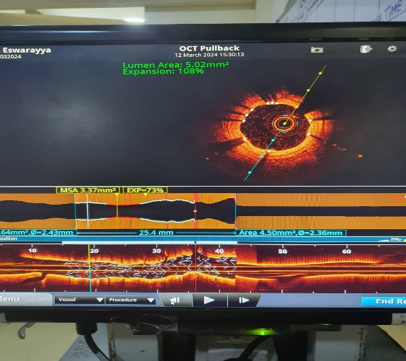
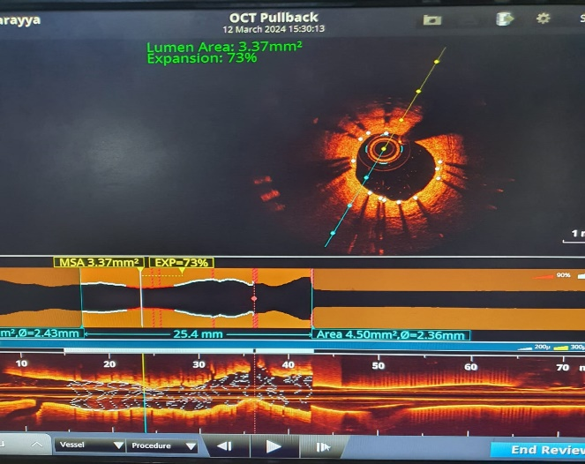
OCT RUN
07

Slide 8
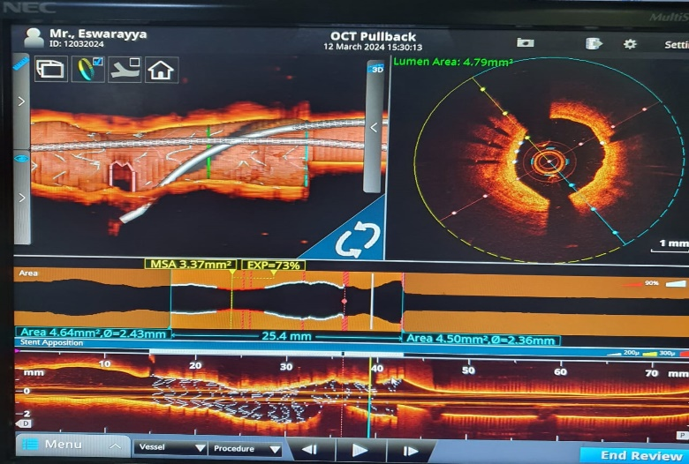
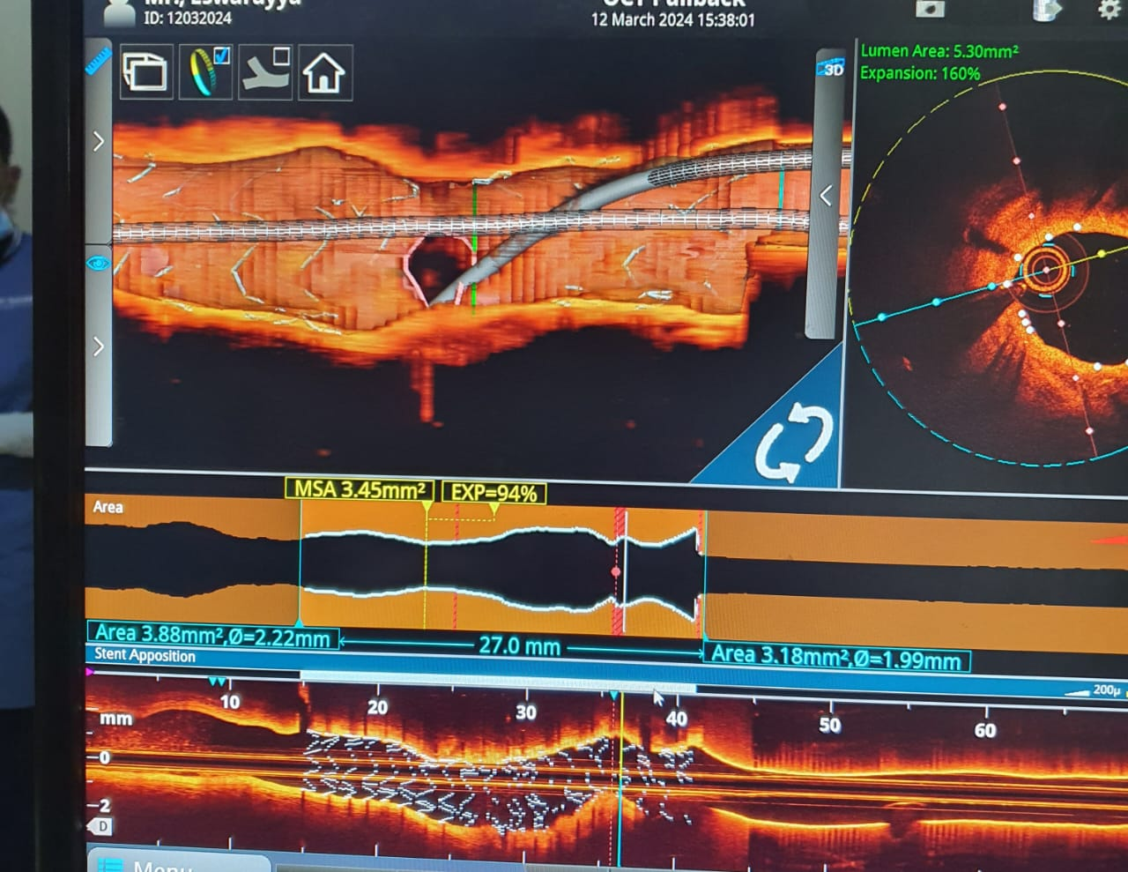

Slide 10
08
DILATION IN LCX STENT

Slide 11
12
KISSING BALLOON
POT

Slide 12
STENT DEPLOYMENT
10

Slide 13
POT
RECROSSING

Slide 14
KISSING BALLON
OCT RUN

Slide 15
STENT DEFORMATION

Slide 16
MLA LMCA
MLA LAD

Slide 17
FINAL SHOOT

Slide 18
16
Take home message
1.Complex Bifurcation stenting needs imaging for better outcomes as 1 mm square increase in MSA decreases All Cause Mortality By 40%
2.OCT particularly helps in distal strut wire recrossing and apt landing zones before stenting.
3.Post stenting OCT helps in looking for MLAs and stent apposition.
4.Out Comes for CABG Vs Image guided PCI For complex Bifurcation is still under Debate.

