Slide 1
THE JOURNEY OF AMYLOIDOSIS-THE GREAT MIMICKER
Dr. T. GOMATHI MD., DM
Assistant Professor of Cardiology
Thanjavur Medical College

Slide 2
History
50 year old female
Initially treated as pulmonary arterial hypertension for two years
presented with shortness of breath and swelling of both lower limbs
We diagnosed as rheumatic heart disease with pulmonary arterial hypertension

Slide 3
Follow up visit
History of change in the voice
Multiple joint pain
burning sensation of feet and hands
Dryness of mouth and eye
Weight loss, fatigue, loss of appetite

Slide 4
JVP - elevated
Bilateral pitting pedal edema
B/L submandibular gland enlarged, firm macroglossia
B/L conjunctival redness
Hyperemic fingers, suffused soles
CVS – loud P2, Ejection Systolic Murmur 3/6 pulmonary area
NT pro BNP 3561
Trop T 21.2 pg per/ml
Urine Bence Jones Protine - Negative

Slide 5
Mildly hypocellular marrow with mild megalo blastic changes and markedly reduced stainable iron stores. No abnormal cells
Kappa 16.8 lambda 337 K/L = 0.04
Urine PCR 1.77
Viral markers negative
PT/APTT normal
Abdominal fat pad biopsy – Amyloidosis
Normal Immuno Fluro Electrophoresis

Slide 6
ANA negative
ECG – Low voltage complexes, LAE
ECHO
Biatrial enlargement, Biventricular wall thickening
Thickened valves and restricted mobility
Preserved biventricular systolic function
Grade III LV Diastolic dysfunction
Severely reduced mitral annular tissue Doppler velocity
Moderate Pulmonary arterial hypertension
Mild pericardial effusion

Slide 9
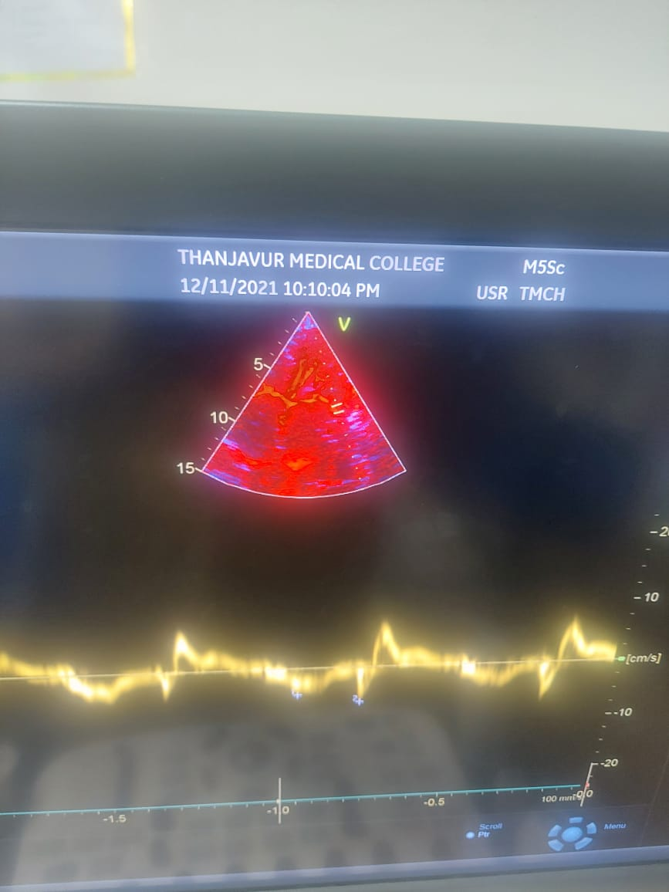

Slide 10
Cardiac MRI
T1 SCOUT – Myocardium nulls before blood
Lateral valves nulls earlier compared to the septum
Global transmural delayed hyper enhancement involving the sub endocardium of both ventricles atrias and IAS
DD
1) Amyloidosis 2) Acromegaly

Slide 11
Final diagnosis
Primary amyloidosis (AL)
(Cardiac, Renal, Eye, Tongue, Nerve)
Congestive cardiac failure
She was treated with thalidomide based chemotherapy, steroid and diuretics
After one year she developed acute onset of breathlessness and diagnosed as acute pulmonary thrombo embolism – lysed with streptokinase
She is on follow up for 5 years

Slide 12
Conclusion
AMYLOIDOSIS is a pandora of box
Unravelling the mysteries behind it needs a lot of understanding and knowledge about the disease
Early diagnosis, appropriate management and follow up are essential for survival
The efficacy newer therapeutics are dependant on early diagnosis.

