Slide 1
Close shave with coronary perforation
Dr. Ganga Velayudhan
Aster Medcity cochin
Modern Hospital cochin
Kerala

Slide 2
History
65/F diabetic with recent NSTEMI – IW
Good LV, Angina on exertion class II
CAG RCA – 95% Prox to mid, LAD – distal 70% Lcx, Non dominant – 70% prox and distal, OM – 80%
Plan – PCI to RCA for now

Slide 3
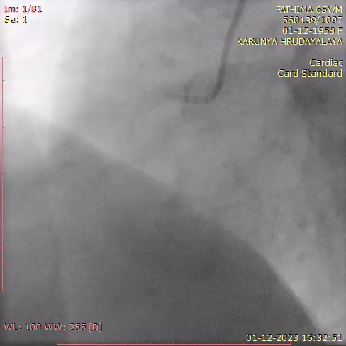
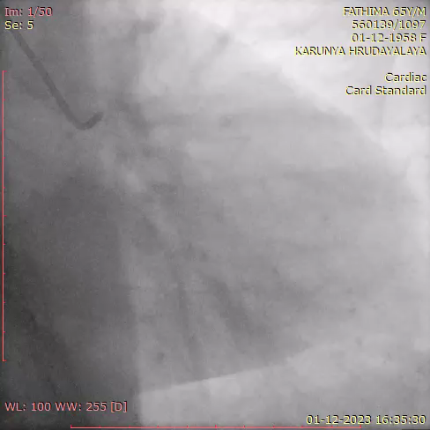
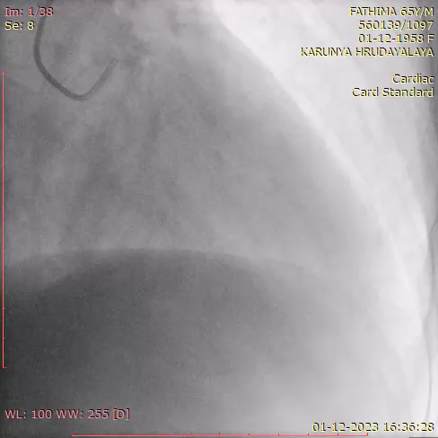

Slide 4
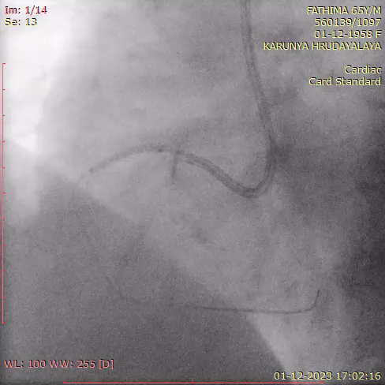
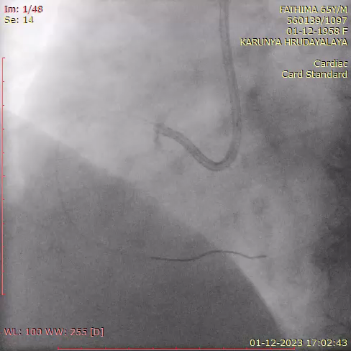
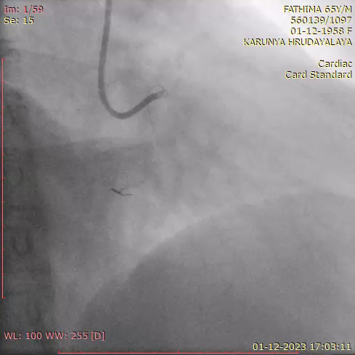
6F AR 2.0 Guide, Fielder FC wire, Predilated 2 x 15 NC balloon

Slide 5
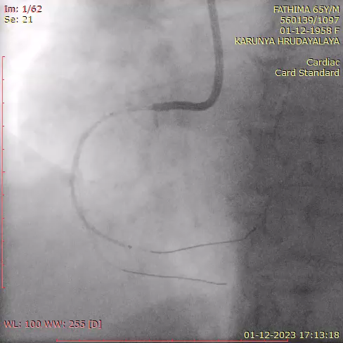
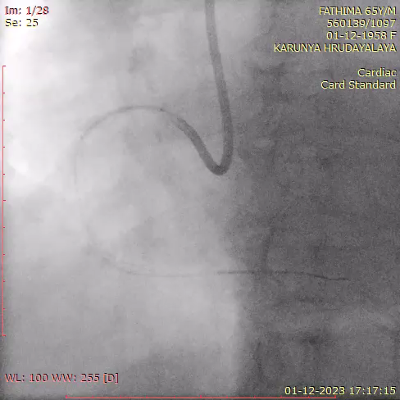
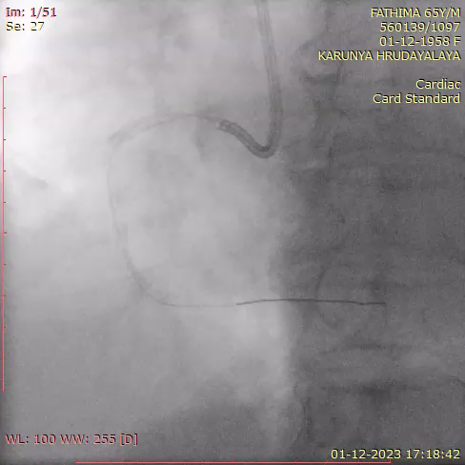
Distal stent 2.5 x 48 DES
Proximal 2.75 x 21 DES

Slide 6
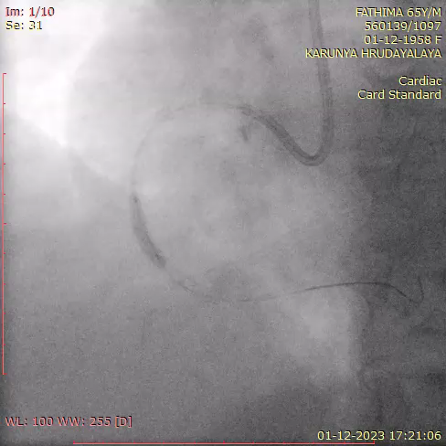
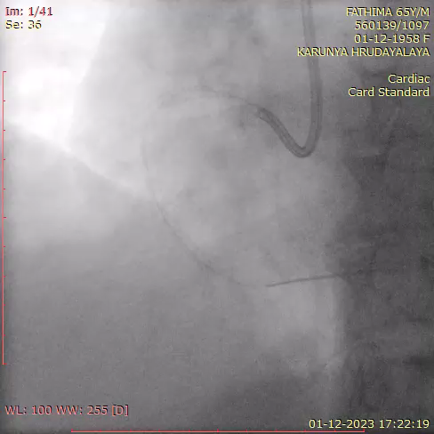
Post dilated 2.75 x 15 NC balloon

Slide 7
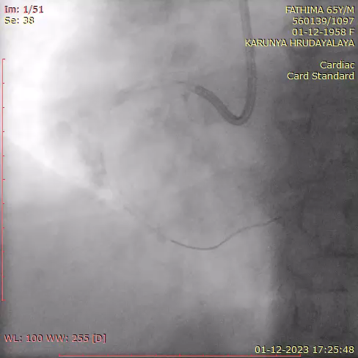
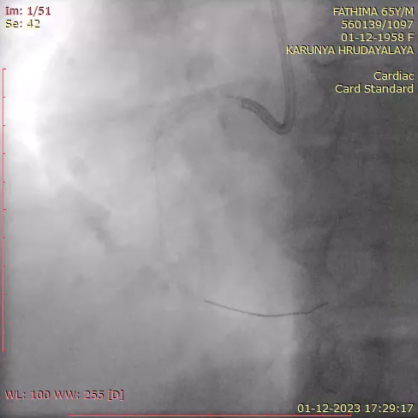
Balloon holding 2.75 x 15 NC balloon for 5 mins
Perforation seemed to hold off but….

Slide 8
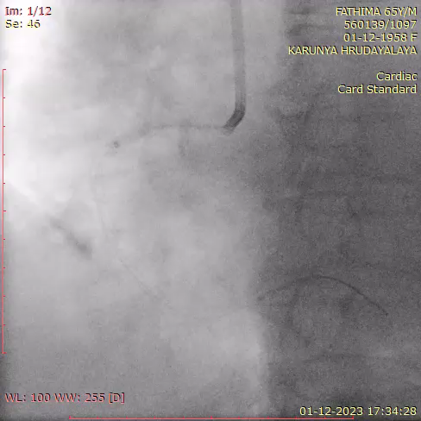
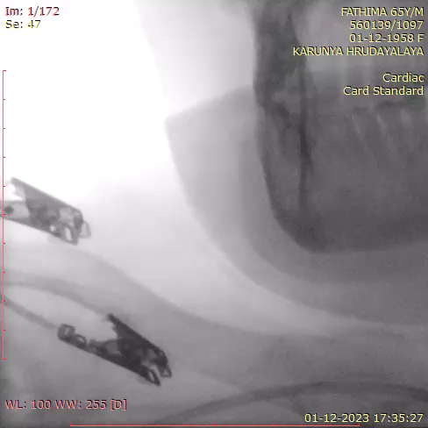
Decided to deploy covered stent 2.75 x 19 Graftmaster, not tracking!

Slide 9
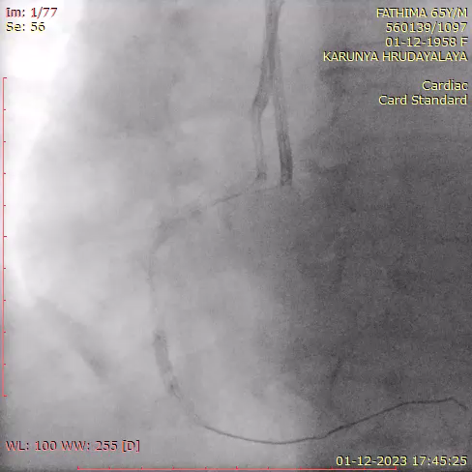
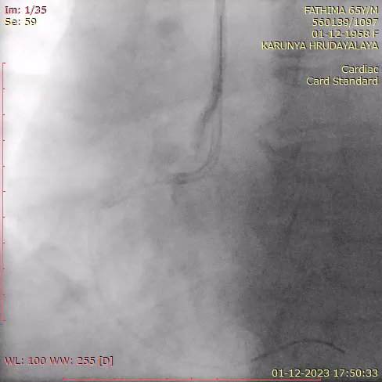
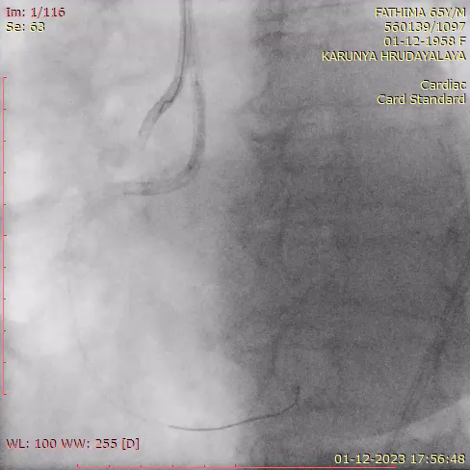
6F Femoral access
JR 3 guide another wire
Proximal stent post dilated with 3.0 x 10 NC balloon
Reattempt to place graftmaster, not tracking

Slide 10
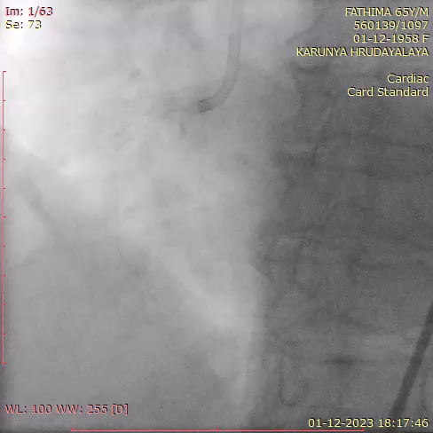
More bleeding!!!

Slide 11
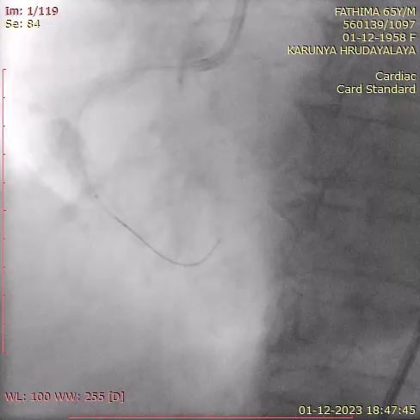
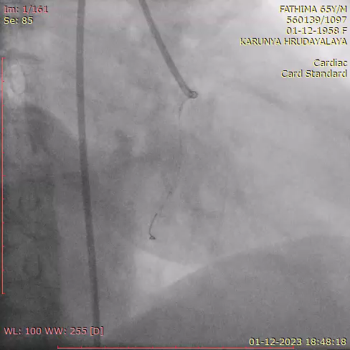
Prolonged balloon holding, intermittently for close to half hour
ACT 180 sec, no reversal done
Echo – mild effusion, not tapped
BP maintained, stopped and observed
CCU patient stable, antiplatelets withheld
Single antiplatelet restarted after 18 hours
Patient discharged after 3 days

Slide 12
Take Home points
Careful stent and balloon assessment to prevent coronary perforations
Prolonged balloon holding
Heparin reversal
Covered stent
  Double guide technique
Gel foam, coils
Surgery

