Slide 1
Man Proposes
God Disposes
-Dr. Shalini Garg
DM Cardiology
Senior interventional cardiologist
Metro Hospital, Jaipur

Slide 2
Pt Mrs xyz was admitted with chief complaints of chest pain x 1day along with diaphoresis and ghabrahat.
Pt is a k/c/o T2DM, CAD /Old NSTEMI with H/O PTCA+stent to LAD in sept 2022 in another hospital
Again pt had ACS and she underwent PTCA +stent LMCA to LAD in jan 2023 in same hospital
Again pt was admitted with similar complaints in another hospital and check cag showed ISR in LMCA to LAD and mid LAD with 80-90%stenosis in osteoproximal lcx. There pt underwent PTCA with DEB in LAD stent.

Slide 3
In present admission ECG was suggestive of diffuse ST-T depression in anterior precordial leads
Pt was diagnosed as having CAD/ACS/NSTEMI with severe anaemia and thrombocytopenia.
2 D echo showed no RWMA with lvef - 55%
Pt was transfused 2 units of blood with improvement in CBC Parameters. Stool for occult blood loss was negative
Pt was taken for cag after repeated denial and persuasion.
CAG was suggestive of LMCA -99%stenosis with LAD Showing diffuse ISR of 80%
and Ostial LCX 90%stenosis.

Slide 4
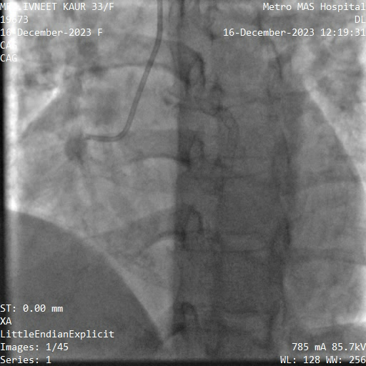
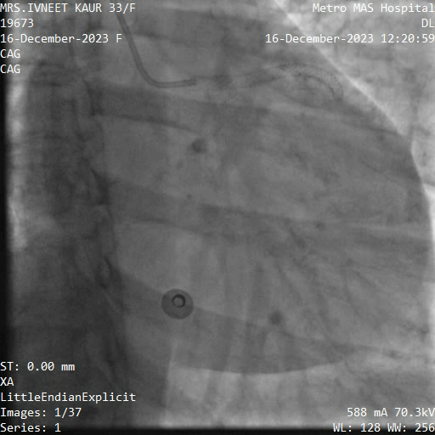
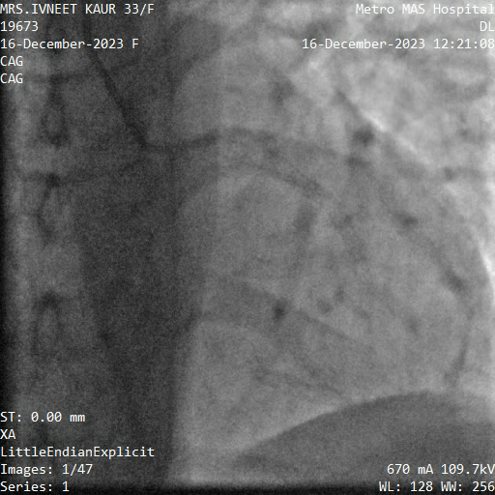

Slide 5
Thrombochek profile was sent to find out cause for recurrent restenosis
Pt was advised CABG and put on heparin.
Pt attendants wanted second opinion so they wanted to buy some time .

Slide 6
After 1 day Pt suddenly developed severe chest pain with hypotension.
Ecg was suggestive of Acute AWMI and echo showed RWMA in LAD Territory with lvef -40%
Pt was taken to Cathlab and high risk consent and refusal for cabg consent taken from pt attendants.
LMCA hooked with 7 F XBU 3.0 catheter via right femoral route 7 F sheath.
LAD lesion crossed with BMW wire .
Predilatation in LMCA and LAD done with 2.0x12 mm semi compliant balloon.
Lesion in LCX crossed with another BMW wire and predilatation done with 2.0x12 mm Semicompliant balloon
Again predilatation of LAD, LMCA and LCX lesions done with 2.5x12mm NC Balloon at 16-18 atm.

Slide 7
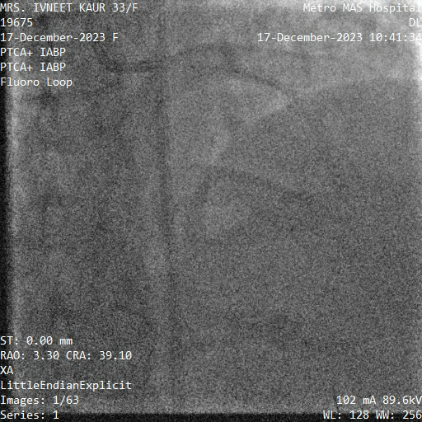
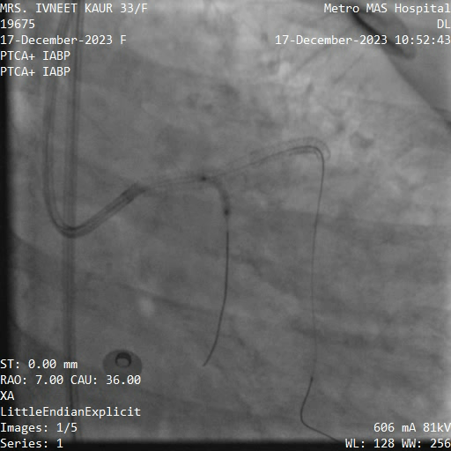

Slide 8
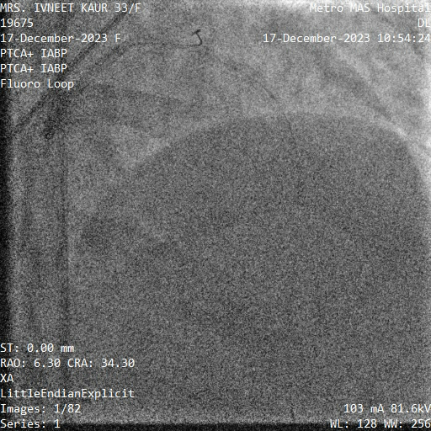
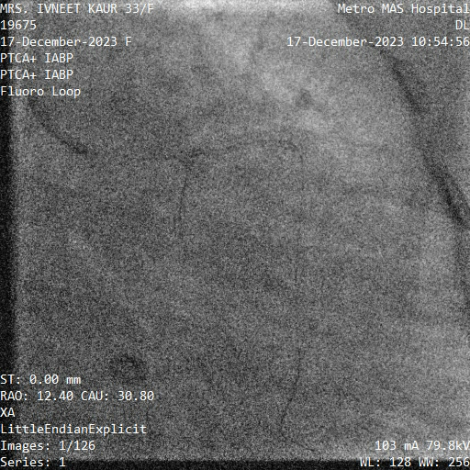
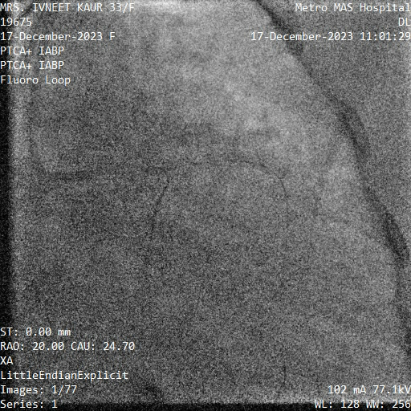
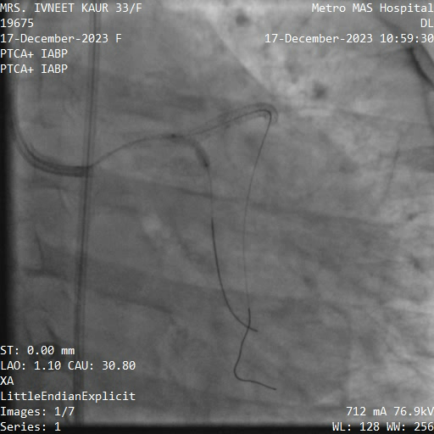

Slide 9
3.5 x33 mm DES implanted in distal LAD lesion at 10 atm
4.0x38 mm des implanted from LMCA to LAD at 10 atm.
Then post stent dilation done with 3.5x15 mm NC balloon and 4.0x10 mm NC balloon in LAD and LMCA Respectively.

Slide 10
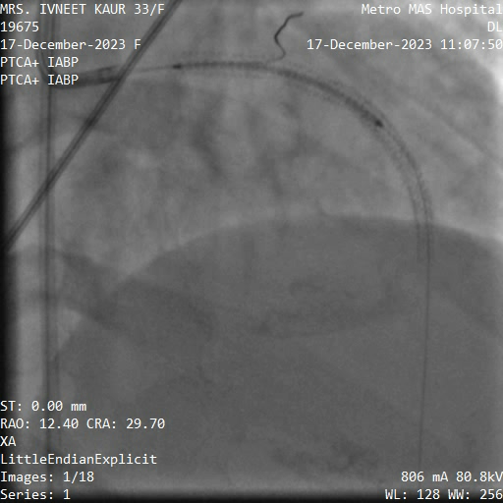
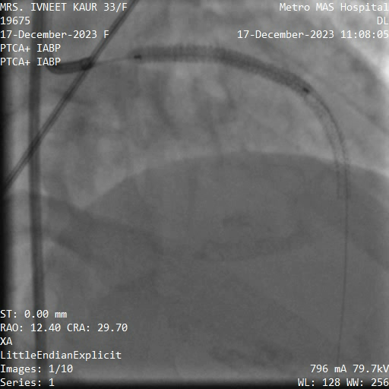
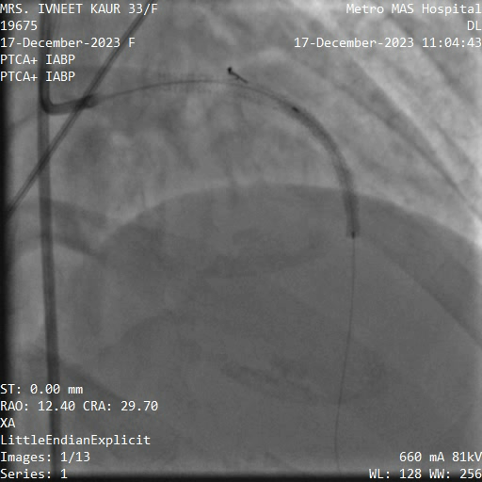
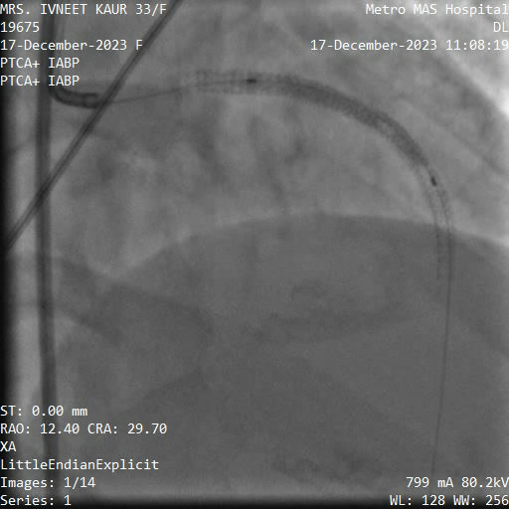
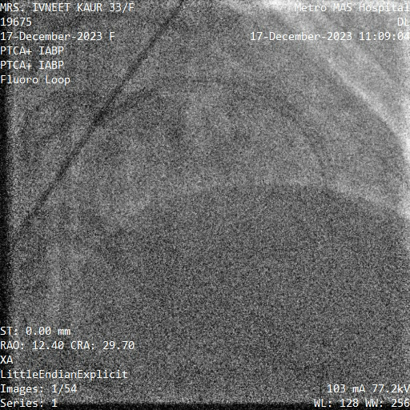

Slide 11
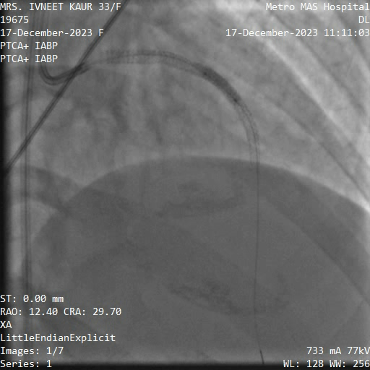
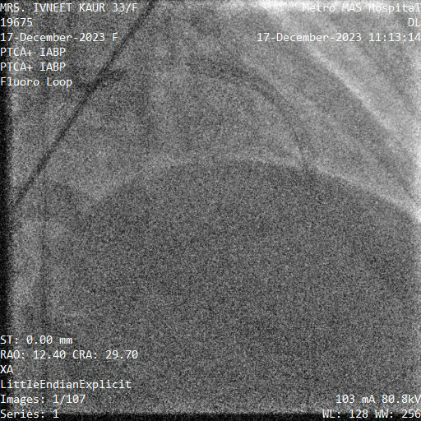

Slide 12
Results were satisfactory with TIMI -III Flow in LAD and LCX
Imagining can’t be done because of cost restraints.

Slide 13
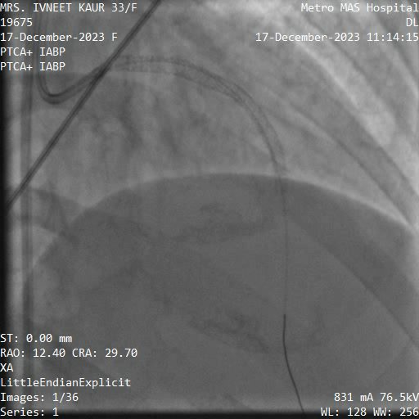
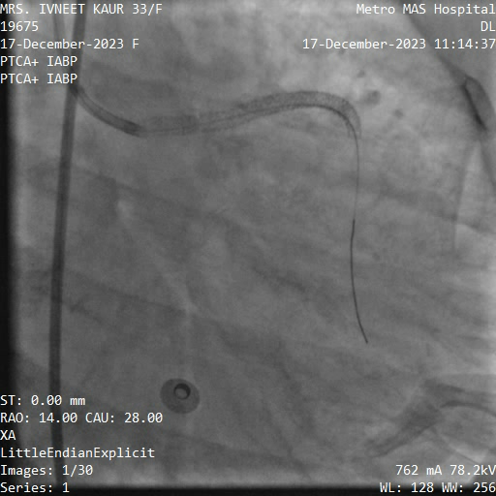

Slide 14
Thrombochek profile came out to be normal.
Pt was already on ecosprin , ticagrelor and rosuvastatin during her previous procedures also.
In this admission bempedoic acid and ezetemibe added over rosuvastatin along with other DMD’s.
She was advised cag after 1 month.
She is symptom free and in regular follow-up but refused for cag due to apprehension.

