Slide 1
A DYNAMIC ENIGMA: RATE DEPENDENT - LEFT BUNDLE BRANCH BLOCK
Presenter: Dr. Abhishek Samdesi C N (3rd year DM Cardiology Resident)
Dr. B Asha Latha – HOD & Professor, Dept of Cardiology
Sapthagiri Institute of Medical Sciences and Research center, Bangalore

Slide 2
CASE HISTORY
A 65 year old female, referred from ENT department for Cardiac fitness for Surgery.
Newly diagnosed with Hypothyroidism
ECG: Sinus rhythm, with heart rate of 80bpm, regular and inverted T waves in I, aVL, II, aVF, V3-6
TMT: Patient developed Rate dependent –LBBB with Chest pain.

Slide 3
CORONARY ANGIOGRAM:
LMCA: Normal
LAD: Type II, Proximal to Mid LAD long segment maximum 90% lesion
LCX: Non-dominant, Ostial 20-30% stenosis, Proximal to distal long segment 90% lesion
RCA: Dominant, Normal
PTCA + stenting done to LAD ad LCX.
Patient on follow up is stable and has no complaints.

Slide 4
BASELINE ECG

Slide 5
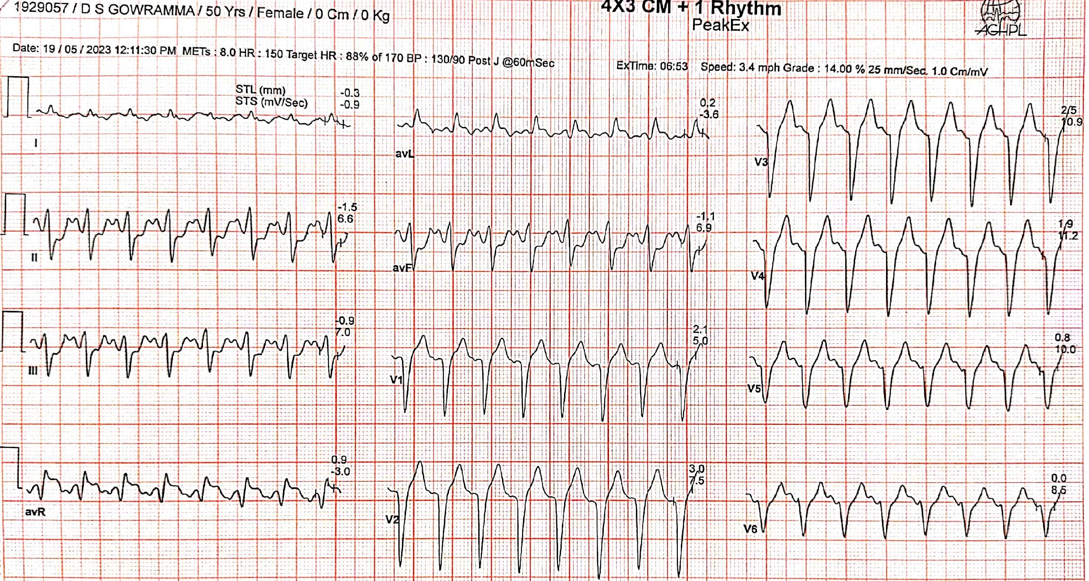
ECG on TMT during Peak Exercise

Slide 6
ECG on TMT during RECOVERY

Slide 7
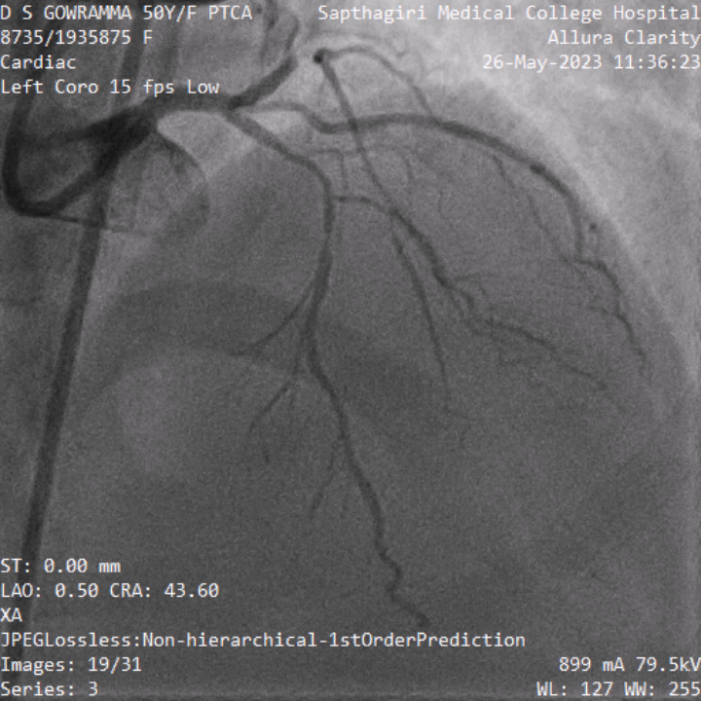
CORONARY ANGIOGRAM
LCX shows Ostial 20-30% stenosis, Proximal to mid long segment 90% lesion
LAD shows Proximal to Mid long segment maximum 90% lesion

Slide 8
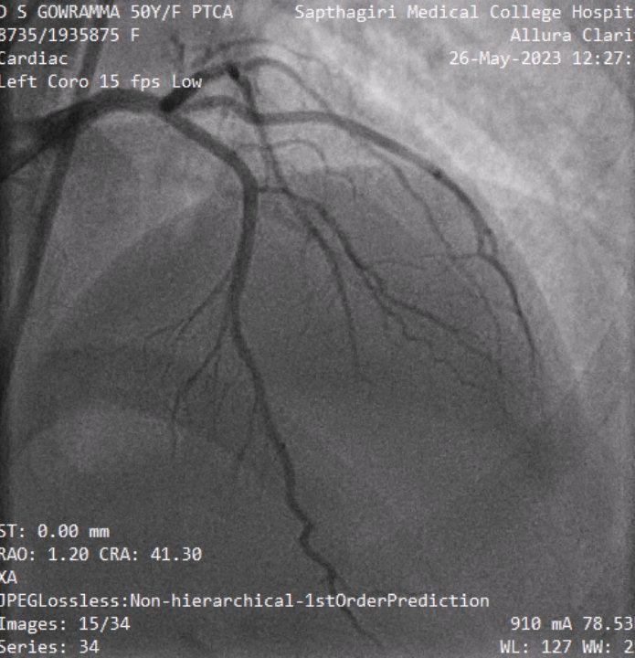
POST PTCA STENTING TO LAD AND LCX
PTCA stenting to LCX, TIMI III flow
PTCA stenting to LAD, TIMI III flow

Slide 9
TAKE HOME MESSAGE
RD- LBBB is a rare electrocardiographic occurrence that may be detected during exercise testing.
Patients with this RD-LBBB is usually considered benign and its presence is associated with higher all-cause mortality rates.
Occurrence of RD-LBBB during TMT may be a direct evidence for ischemia as seen in our case.

