Slide 1
A crush “reversed”
Dr .K. Naga Chaitanya
Aster mims hospital,calicut

Slide 2
63 year old lady
DM and HTN
Central chest pain of 10 hrs duration
Hemodynamically stable
ECG : within normal limits
Echo : RWMA in LAD territory with good LV function
Trop I positive

Slide 3
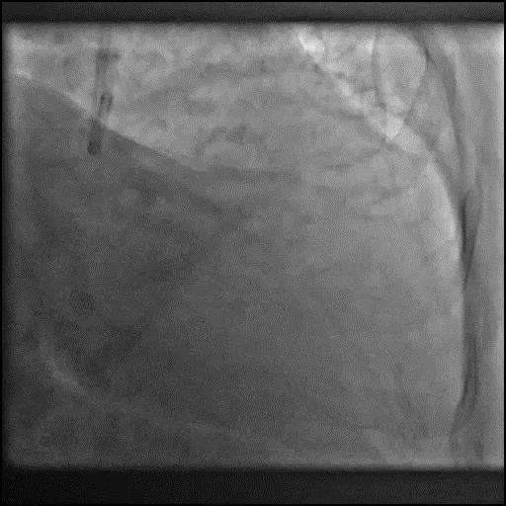
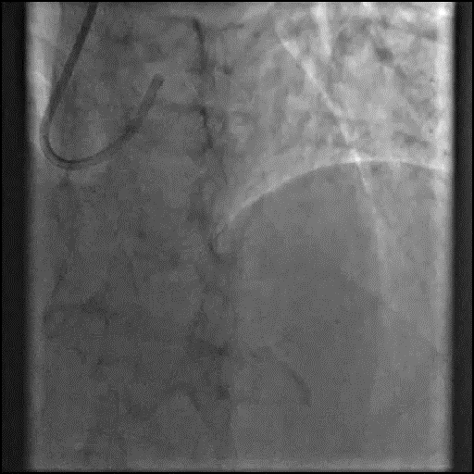
CAG showed Mid LAD 80% stenosis involving ostium of major diagonal(70%) medina 0,1,1 and another discrete 90% stenosis of mid segment of diagonal.

Slide 4
Strategy??
Upfront two stents strategy
Culotte vs crush
DK crush

Slide 5
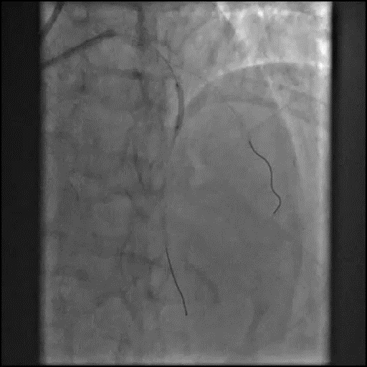
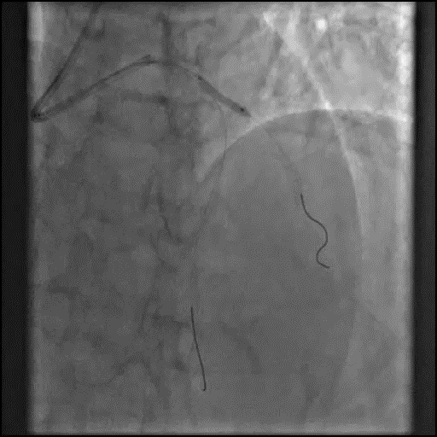
Predilatation of lad with 2.5 * 15 and diagonal ostium with 2.5 * 15 NC balloons

Slide 6
Dissection in diagonal with slow flow…
ST depressions
Hypotension
Decided to stent Diagonal first

Slide 7
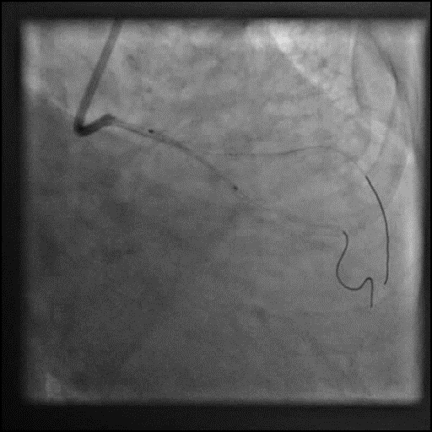
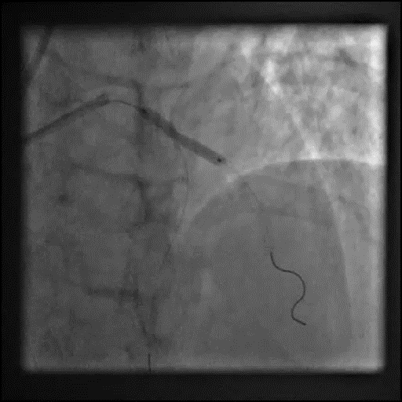
LAD-Diagonal stented with 3 *23 mm DES

Slide 8
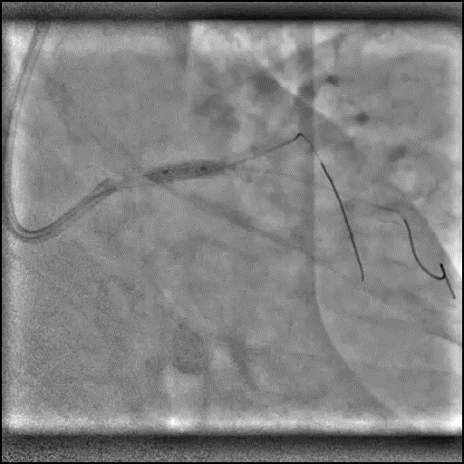
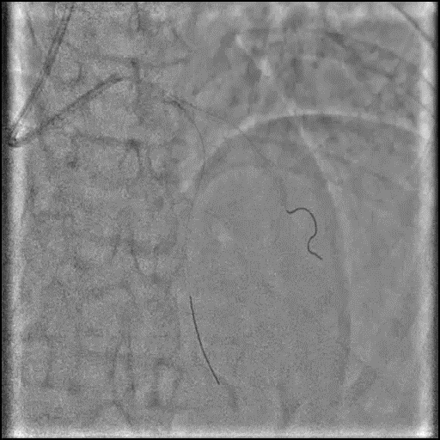
POT done with 3.5 * 8mm NC

Slide 9
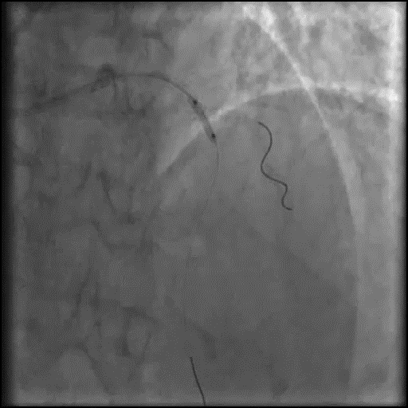
LAD recrossed,strut opened and serial dilatation done with 2 and 2.5mm balloons

Slide 10
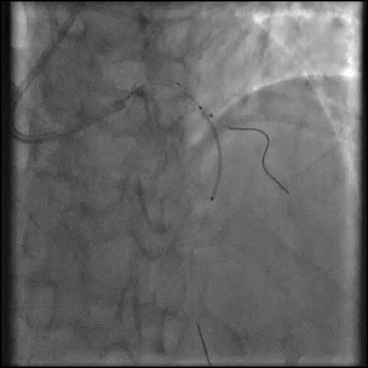
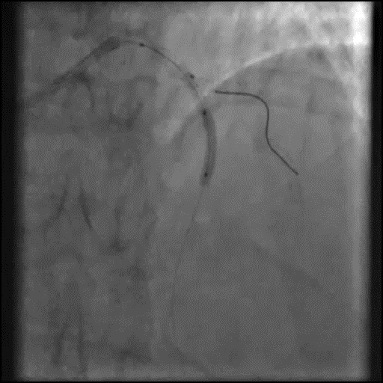
LAD stented using 2.5 * 28 mm DES with 3 * 15mm balloon in LAD- diagonal and post dilated with 2.5 * 15mm NC balloon

Slide 11
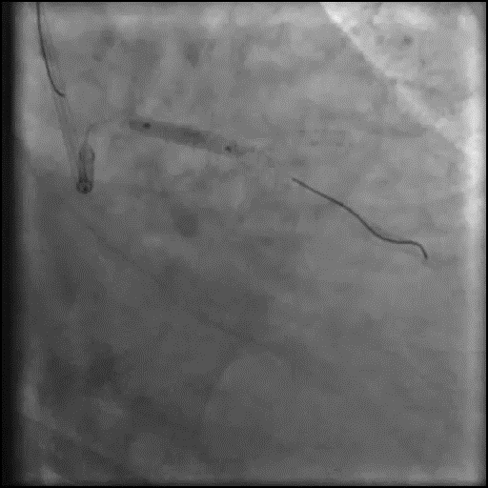
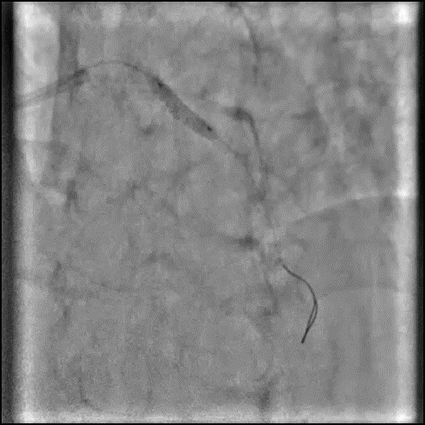
LAD wire removed and stent crushed with 3 * 15 mm Balloon @14atm

Slide 12
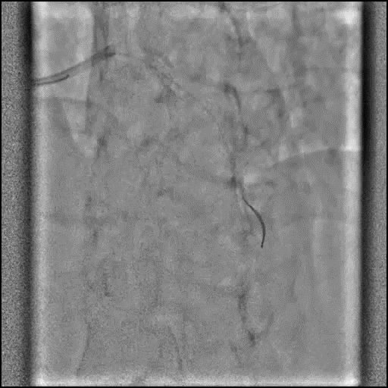
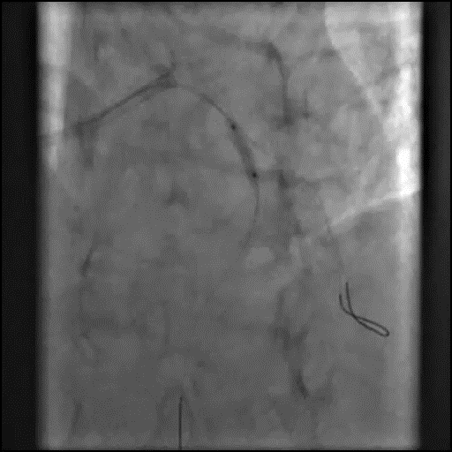
Slow flow…
LAD stent recrossed and serial dilatation done

Slide 13
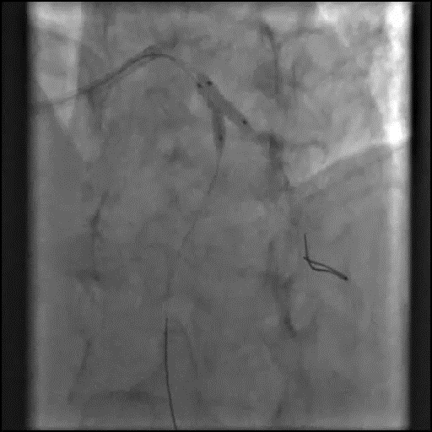
KBI done with 2.5 * 15 mm in LAD and 3 * 12 mm in diagonal @ 12 atm

Slide 14
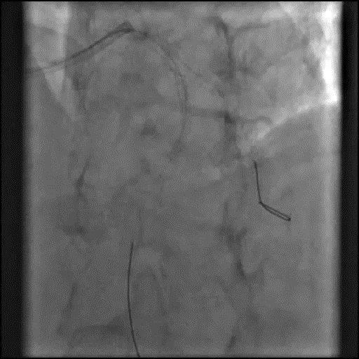
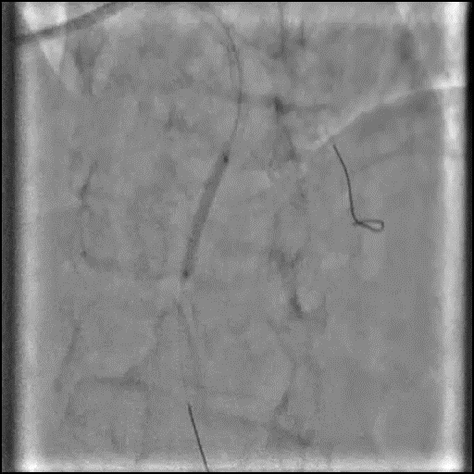
Hazy lesion in mid LAD distal to stent edge, not reolving with vasodilators,? Intramural hematoma, stented with 2.25 *23 mm DES

Slide 15
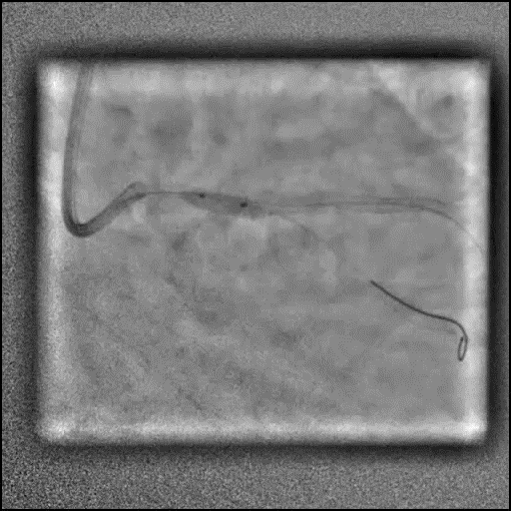
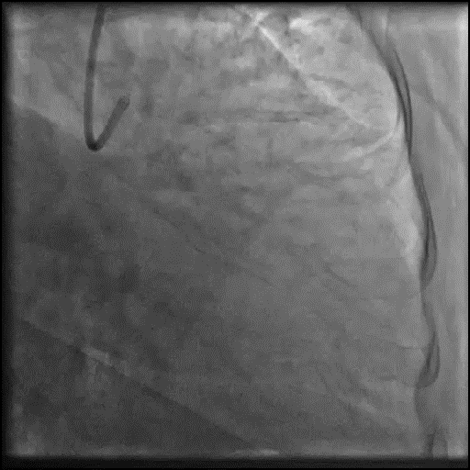
Final POT done with 3.5 * 8 mm NC

Slide 16
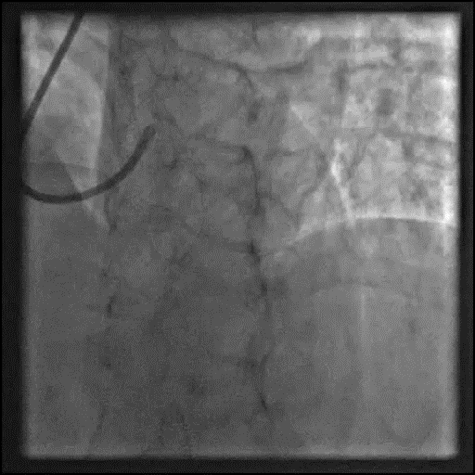
Finally….

Slide 17
Take home message
DK crush is the most extensively studied two stent bifurcation technique and is proved superior to culotte and TAP techniques with good long term outcomes.
Having knowledge of all the contemporary bifurcation strategies helps to bail out the situation.
The optimal result especially in terms of stent expansion is much more important than the the selection of a specific two stent technique.

