Slide 1
BIFURCATION STENTING IN A CASE OF ACUTE STEMI WITH BRADYCARDIA AND HYPOTENSION
DR VARSHA KOUL
SENIOR CONSULTANT CARDIOLOGY
BATRA HOSPITAL AND MEDICAL RESEARCH CENTRE, NEW DELHI

Slide 2
CASE HISTORY
MR A, 49 YEAR OLD MALE, NORMOTENSIVE, NON-DIABETIC, SMOKER
PRESENTED TO ER WITH CHEST PAIN FOR 2 HOURS WITH DIAPHORESIS
ECG- ST ELEVATION IN INFERIOR LEADS
PATIENT GIVEN TABLET ASPIRIN 325 MG, TABLET CLOPIDOGREL 300 MG, TABLET ATORVASTATIN 80 MG AND INJECTION UNFRACTIONATED HEPARIN 5000 U.
PATIENT DEVELOPED BRADYCARDIA AND HYPOTENSION AND WAS IMMEDIATELY SHIFTED TO CARDIAC CATHETERIZATION LAB FOR CORONARY ANGIOGRAPHY AND REVASCULARIZATION

Slide 3
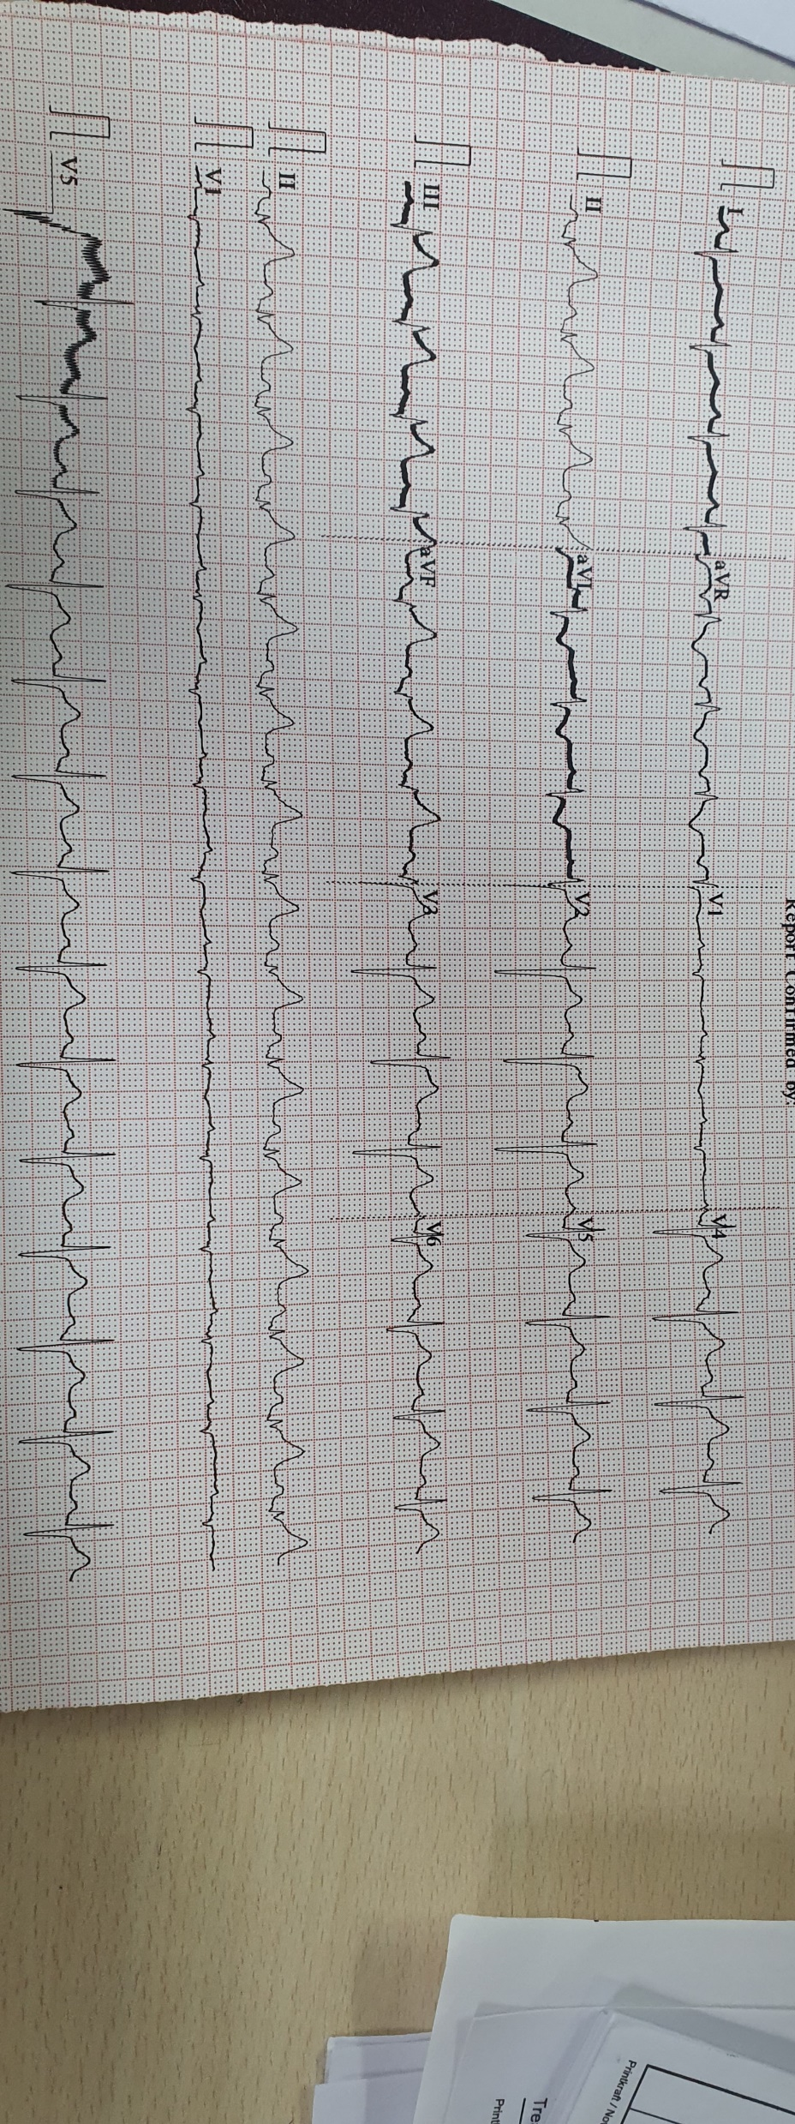
ECG AT PRESENTATION

Slide 4
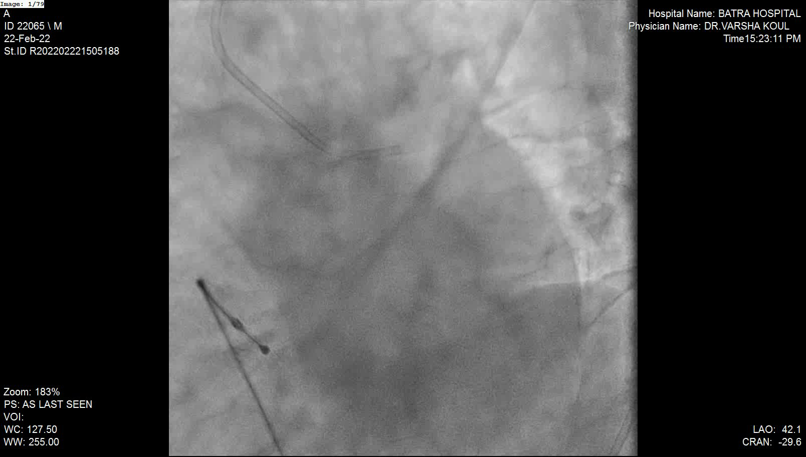
TPI WAS DONE F/B CORONARY ANGIOGRAM SHOWED 100% OCCLUSION OF LCX WITH LARGE THROMBUS BURDEN, OTHER VESSELS NORMAL

Slide 5
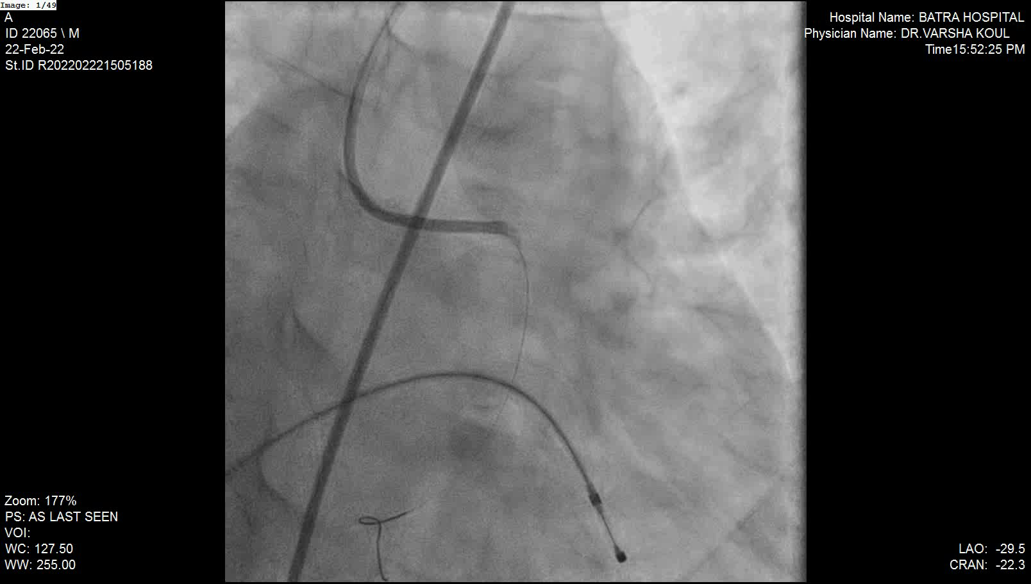
BMW WIRE USED TO CROSS LESION IN LCX.
BIFURCATION LESION LCX,OM1 (1,1,1) SEEN

Slide 6
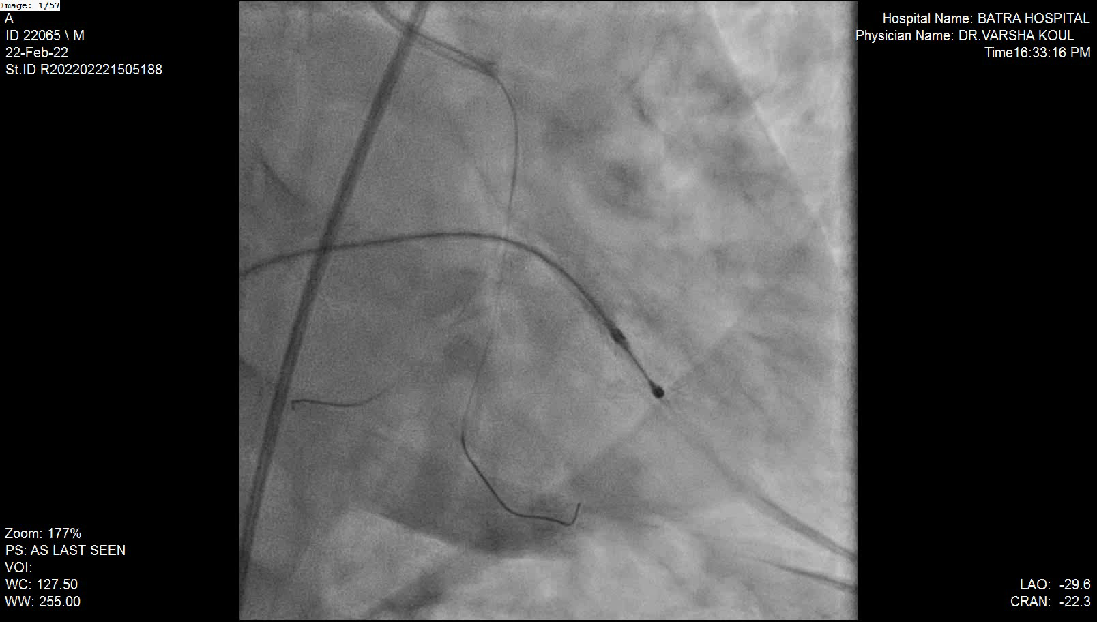
ANOTHER BMW WIRE USED TO CROSS LESION IN LCX, BOTH VESSELS PREDILATED SEQUENTIALLY USING 2.5 X 12 MM BALLON

Slide 7
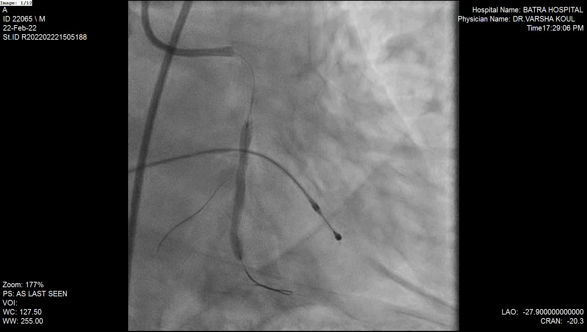
3 X 36 MM STENT DEPLOYED IN OM1 AND POST DILATED USING 3.5 X 12 MM NC BALLOON

Slide 8
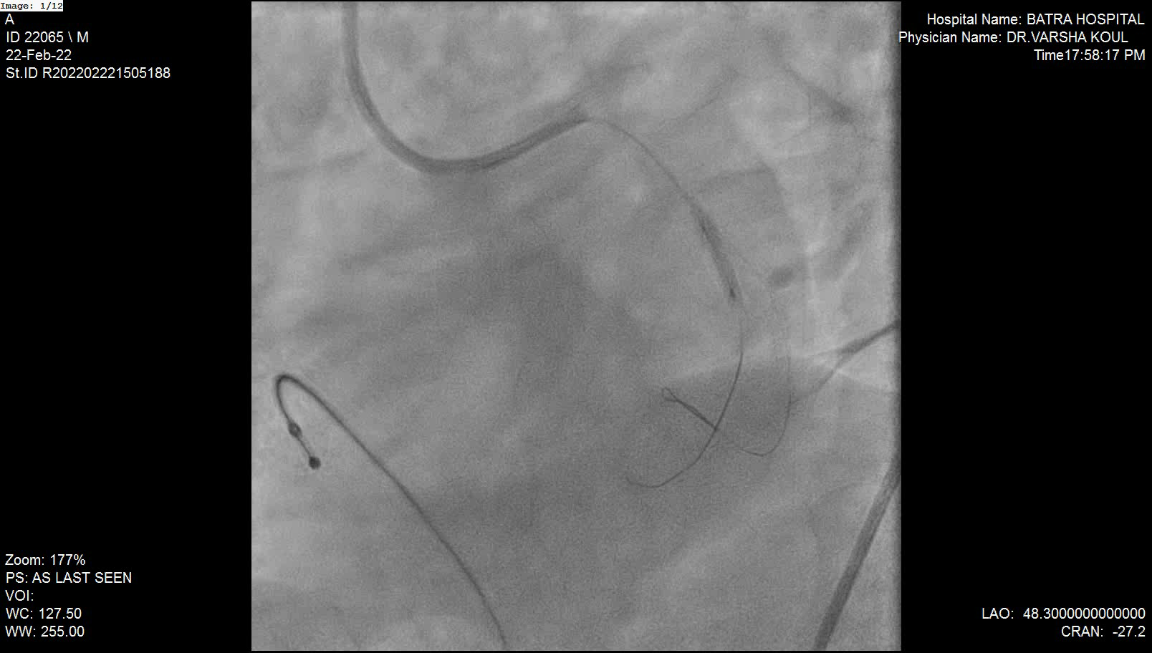
WHISPER WIRE USED TO RECROSS INTO LCX.
STENT STRUTS SEQUENTIALLY DILATED USING 1.5 X 12 MM AND 2.5 X 12 MM BALLOONS
3 X 16 MM STENT DEPLOYED IN LCX

Slide 9
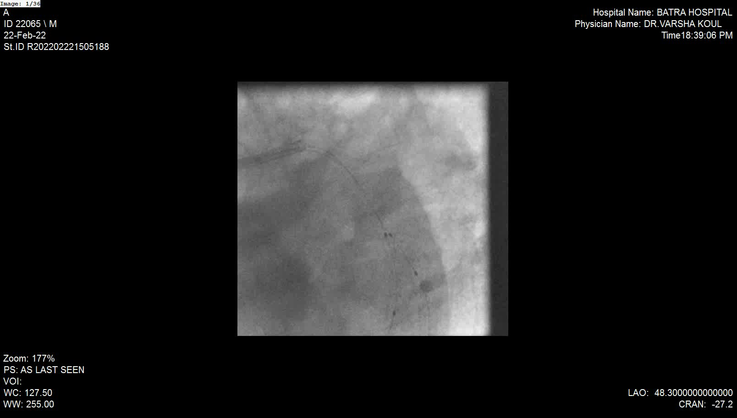
SKBI USING 3 X 16 MM STENT BALLOON IN LCX AND 3 X 12 NC BALLOON IN OM1

Slide 10
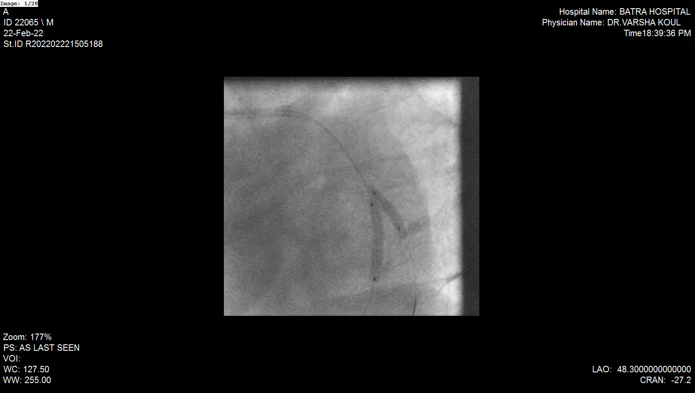
SKBI USING 3 X 16 MM STENT BALLOON IN LCX AND 3 X 12 NC BALLOON IN OM1

Slide 11
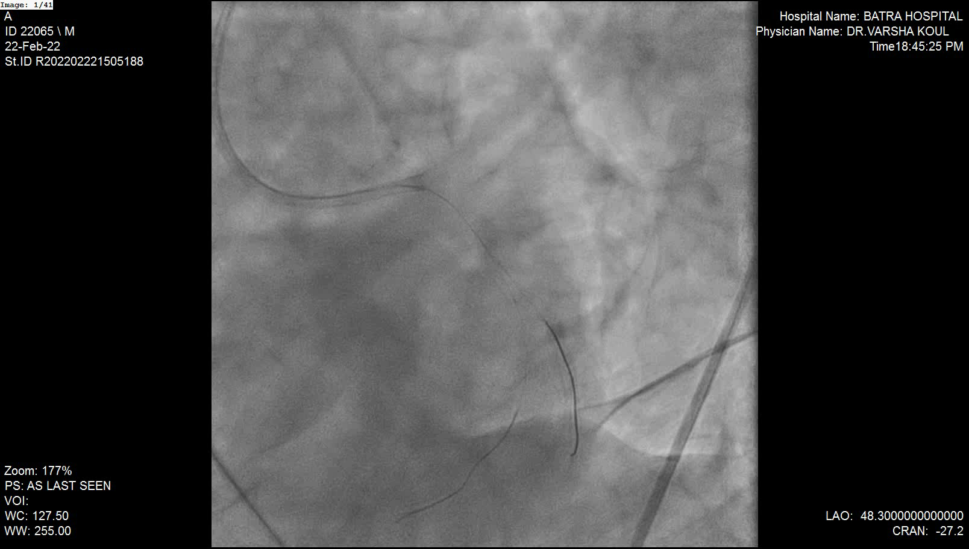
RESULT AFTER FINAL POT USING 3.5 X 8 NC BALLOON

Slide 12
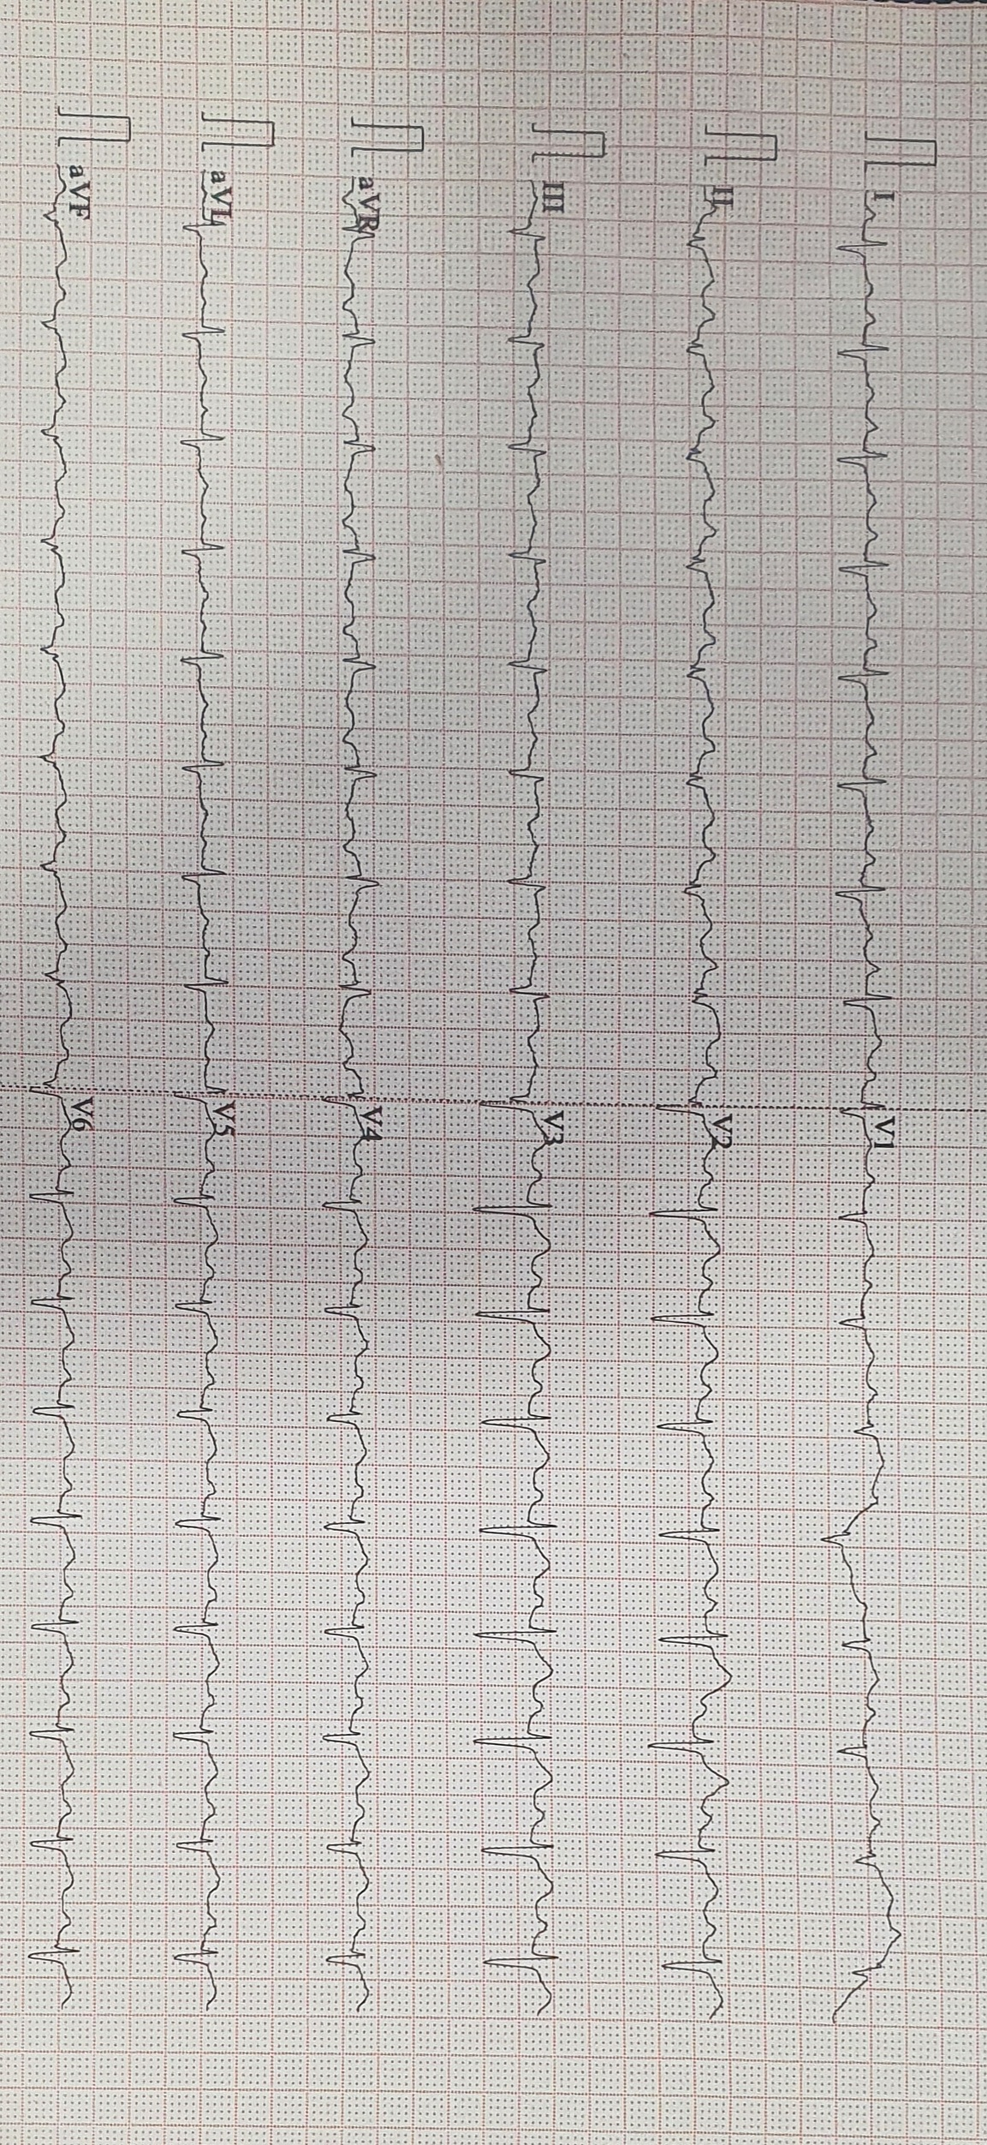
TAKE HOME MESSAGE
PATIENT IS DOING WELL AT ALMOST 2 YEARS OF FOLLOW UP.
IN STEMI WITH TOTAL OCCLUSIONS, UNEXPECTED SURPRISES MAY BE UNEARTHED LIKE BIFURCATIONS, HEAVY CALCIFICATION ETC. ONCE THE FLOW IS RESTORED
ANY BIFURCATION TECHNIQUE WHICH CAN ACHIEVE THE BEST RESULTS IN THE SHORTEST POSSIBLE TIME IS BENEFICIAL, EVEN IF UNCONVENTIONAL AS WE ALL KNOW THAT
TIME IS MUSCLE

