Slide 1
TYPE III STENT FRACTURE DURING OSTIAL RCA STENTING IN A CASE OF TAKAYASU ARTERITIS
DR VARSHA KOUL
SENIOR CONSULTANT
BATRA HOSPITAL AND MEDICAL RESEARCH CENTRE

Slide 2
PATIENT HISTORY
38 Year old Female known case of Takayasu arteritis with past history of right sided hemiparesis and bilateral carotid & subclavian stenosis
Was on methotrexate, low dose steroids and antiplatelets.
Had complaints of chest pain on exertion radiating to left arm since 2-3 months aggravated since 1 week.
ECG- ST depression in inferior and lateral leads.
Patient was admitted for coronary angiography

Slide 3
CORONARY ANGIOGRAM
LEFT MAIN STEM – MILD OSTIAL DISEASE
LAD- TYPE III VESSEL, NORMAL
LCX- NORMAL
RCA- DOMINANT, OSTIAL 90%STENOSIS

Slide 4
RIGHT CORONARY ANGIOGRAM

Slide 5
PRE DILATATION
WHISPER wire used
Lesion predilated using 2.5 x 12 mm semi compliant balloon.

Slide 6
STENT PLACEMENT
4X 18 MM SIROLIMUS ELUTING
STENT DEPLOYED IN OSTIAL RCA
at 11 atm.

Slide 7
POST DILATATION
POST DILATATION OF STENT DONE
USING 4.5 X 12 NC BALLOON AT
12 ATMOSPHERES

Slide 8
STENT BOOST
BUT ON STENT BOOST IMAGES, A CLEAR STENT FRACTURE WAS VISUALISED

Slide 9
SECOND STENT PLACEMENT
A SECOND 4X 18 MM SIROLIMUS ELUTING STENT WAS DEPLOYED ACROSS THE FIRST STENT
POST DILATED WITH 4.5 X 12 NC BALLOON

Slide 10
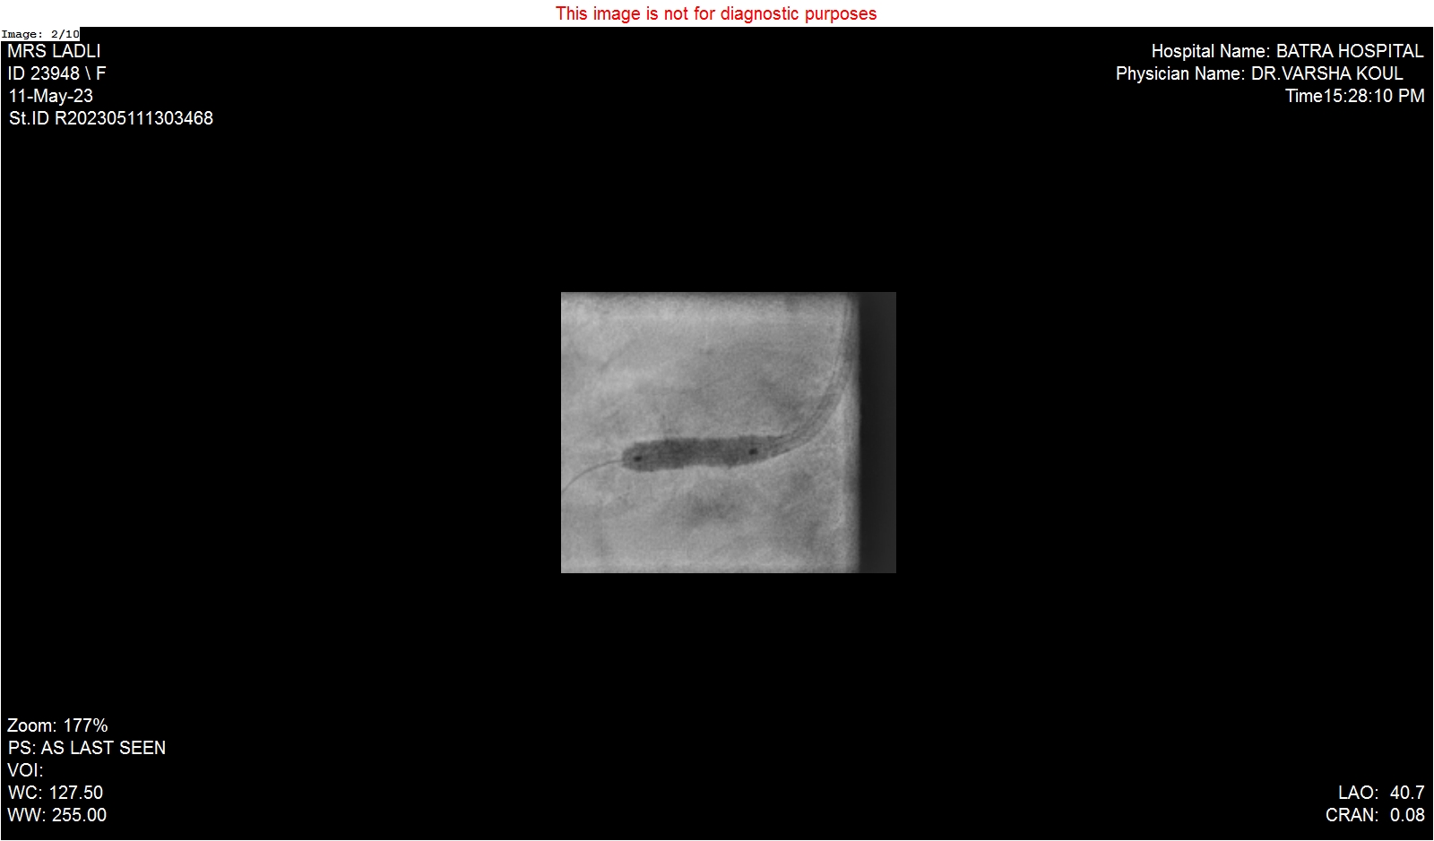
FINAL RESULT

Slide 11
FINAL RESULT

Slide 12
TAKE HOME MESSAGE
PATIENT IS CURRENTLY DOING WELL AT MORE THAN 6 MONTHS OF FOLLOW UP.
UNEXPECTED COMPLICATIONS CAN ARISE IN A SEEMINGLY SIMPLE CASE AT ANY POINT.
STENT FRACTURE CAN SOMETIMES OCCUR ON DEPLOYING STENTS AT VERY HIGH PRESSURES OR ON EXCESSIVE POST DILATATION.
HOWEVER IN THIS CASE , STENT FRACTURE OCCURRED EVEN THOUGH THE STENT WAS DEPLOYED AT NOMINAL PRESSURE AND WITHOUT OVERLY POST DILATING THE STENT. WHETHER THE UNDERLYING AORTOARTERITIS HAD ANY ROLE TO PLAY IN FRACTURE OF THIS STENT IS STILL UNKNOWN.
HOWEVER, ONE HAS TO BE VIGILANT FOR ANY COMPLICATIONS AND DEAL WITH THEM PROMPTLY.
AND REMEMBER ITS NEVER OVER UNTIL ITS ACTUALLY OVER.

