Slide 1
DRUG ELUTING BALLOON FOR CORONARY Bifurcation lesion:A HYBRID STRATEGY
DR. DEVANG DESAI(DM Cardiology ,Senior Interventional Cardiologist)
DR JASMIN VAHORA(DNB Cardiology, Interventional Cardiologist)
UNICARE HEART HOSPITAL & RESEARCH CENTRE,SURAT

Slide 2
DCB-only PCI is very promising -4th Revolution in Coronary interventions.- opened new horizons- Indications for this new technology-
1.Small Vessels <2mm
2.ISR/ Stent delivery failure
3.Branch lesions- OM, Diagonals, PDA, PLV
4. True Bifurcations with long (>5mm) SB lesions or complex SB ISR difficult to treat with DES
5.Bifurcation lesions-DES MB and DCB SB strategy
6.Mid-Distal segments of main vessels
7.Long segment CTO- Long DCB & focal stenting.
8.HBR,Planned recent surgery.
9.PVD- FDA approved in 2016
10. Blocked AV
Excellent tool for revascularization, provided Pre-dilatation is optimal.

Slide 3
Role of DCB in Bifurcation Lesions
DCB treatment of the SB –valuable and safe alternative strategy.
DES in MV and DCB in SB
safe approach with low rate of complications
-BIOLUX-1
-SARPEDON
-DEBSIDE(Denubio DCB)
BABILON- Multicentre randomised study derived
Use of DCB followed by BMS was inferior to a DES strategy in the main vessel.
DCB were characterised by a High safety and efficacy profile when used in the SB

Slide 4
Practical Points Before DCB Usage
Proper Vessel Preparation is a must with available Plaque Modification Tools.
Pre-dilation of the lesion with a Balloon 0.5-1.0 mm. Smaller than the Intended DCB size.
Ensure adequate 1:1 sizing between the vessel and DCB.
Minimise transfer time from access to DCB inflation.
Usage of DCB has to be done as a Drug Delivery Device and not as a Pre-Dilation balloon.
Single Prolonged inflation is better for complete drug transfer from DCB to Vessel usually (60 sec. / total inflation time adding to 60 sec).
If not tolerated by Patient, Fractional release in quick intermittent inflation should be sought for till recommended time is completed with not more than 3 min of DCB in blood stream in deflated state.

Slide 5
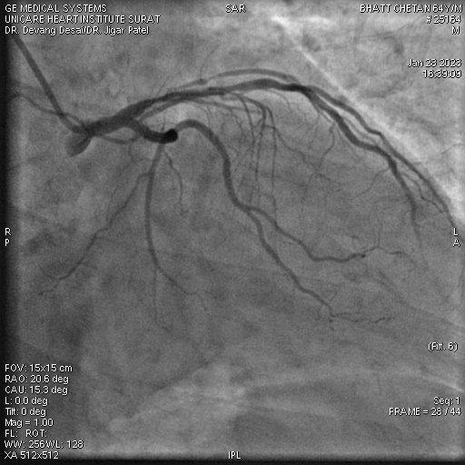
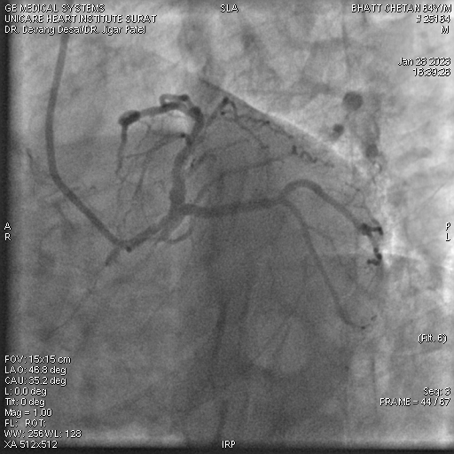
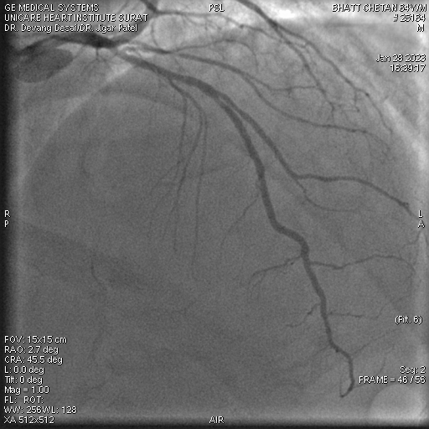
Case
64 year old hypertensive male patient with c/o chest pain
CAG showed Bifurcation lesion LAD,D1
(Medina 1,1,1)

Slide 6
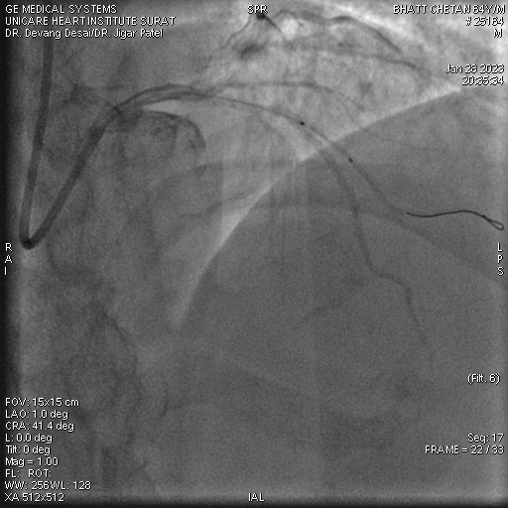
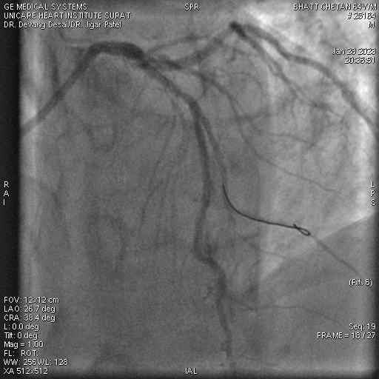
PREDILATATION
D1 lesion was crossed with 0.014”runthrough NS wire
Predilatation of D1 done with 1.5x8 mm
semi compliant balloon

Slide 7
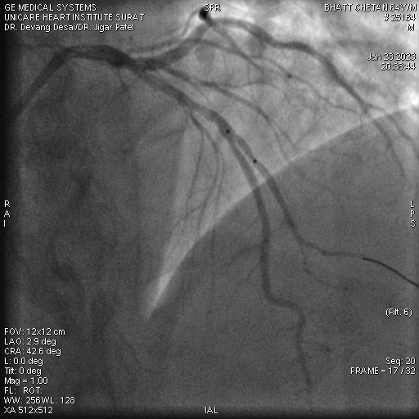
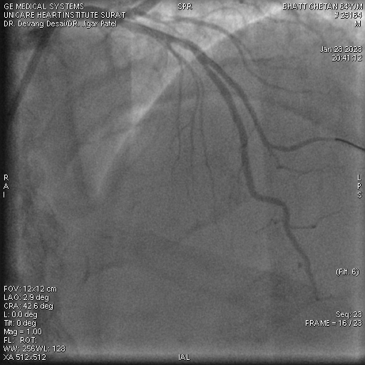
DEB
Drug Eluting Balloon Angioplasty done with 2.00x10mm MAGIC TOUCH DEB at 10 atm

Slide 8
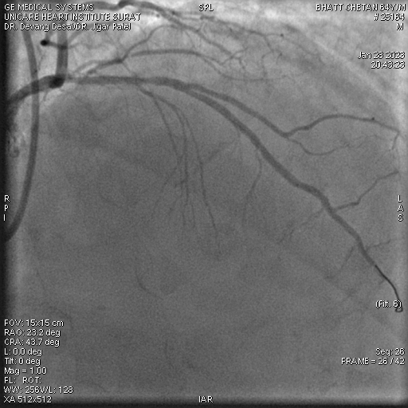
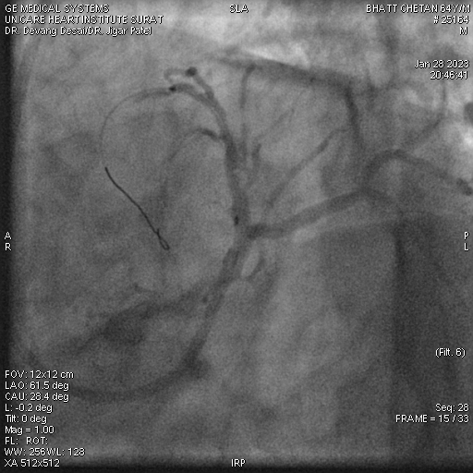
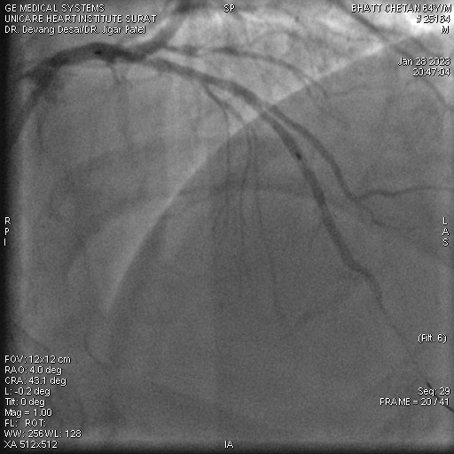
MB STENTING
LAD lesion was crossed with 0.014”runthrough NS wire and predilated with 2.00x12mm balloon at 14 atm

Slide 9
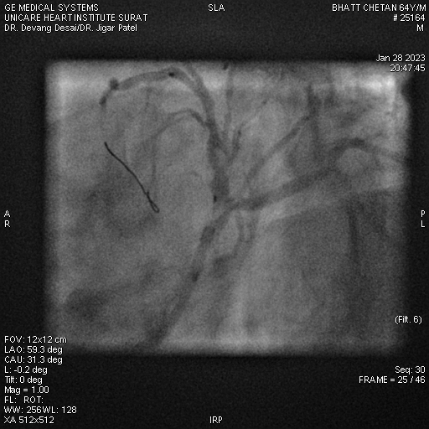
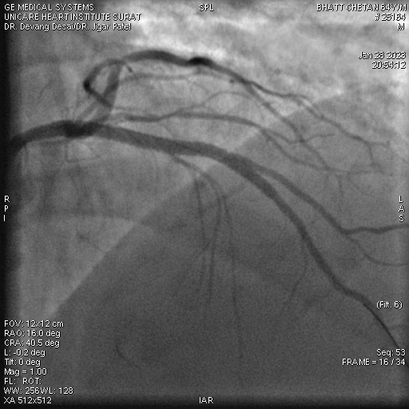
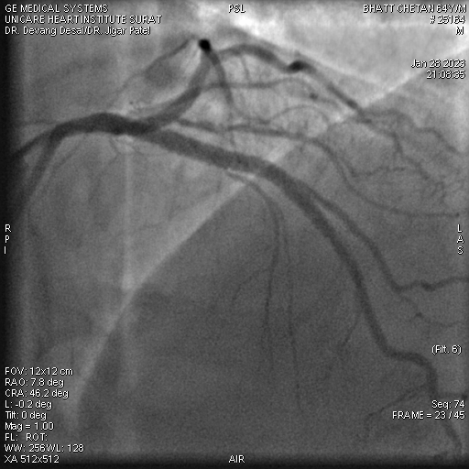
MB STENTING
3.0x48mm DES
was deployed at 14 atm,
Post dilated with 3.5x8mm balloon

Slide 10
FINAL RESULT

