Slide 1
‘MAKING A LM NEO OSTIA’

Slide 2
CASE HISTORY
36 years old HTN,DM ,Smoker male, AOE II for 3 months, p/w Chest pain at rest since 2 days
Diagnosed as ACS-Unstable Angina
O/E – PR -90/min, BP-146/90 S1S2 Normal, CVS Exam-WNL
Other system exam- WNL.
ECG - ST Depression in II,III,aVF
ECHO – Concentric LVH, grade I diastolic dysfunction

Slide 3
ANGIOGRAM

Slide 5
LM 90 % disease involving ostium and shaft
LAD ostial 90 % , mid 80% disease
LCX ostial 90 %
RCA – Free of significant disease
SYNTAX SCORE 25

Slide 6
PLAN
CABG was the FIRST option
1.Stent the MID LAD , FIRST
2.Dedicated 2 stent LM bifurcation by ‘ Cullotte ‘s technique’
Patient had angina on table post angio

Slide 7
PLACING THE LM TO LAD stent

Slide 8
Is the stent well placed ?
The balloon for strut dilatation passing very easily

Slide 9
Rewiring through the stent struts
The stent during implantation got pulled and its proximal part was hanging in the aorta.
The challenge was to place the LCX stent through this overhanging part and to form a NEO LM

Slide 10
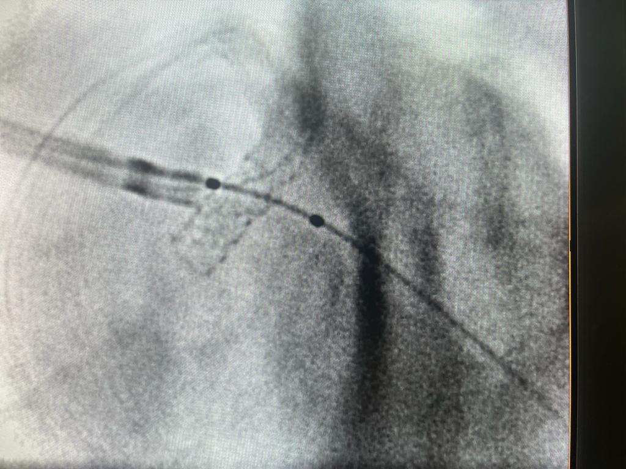

Slide 13
1.NEO LM OSTIA
2.NEO LM SHAFT
3.NEO CARINA

