Slide 1
Zero Metal LM bifurcation PCI In ISR
DR Monika Bhandari
MD,DM, FESC, FSCAI
Additional Profgessor
Dept of Cardiology
KGMU, Lucknow

Slide 2
45 year old diabetic, hypertensive female with CAD
IWMI in 2019/ post PCI to RCA and LAD with DES
ACS/NSTEMI on 20th sept 2023
CAG: LM 50%, LAD stent ISR 80%, ostioproximal RCA 90%, mid stent ISR , diffuse PLV disease
↓
LM /LAD bifurcation PCI and PCI to RCA
Now presented to our ER with ACS/NSTEMI (Trop T- 0.199) with nonlocalizing ST-T changes.

Slide 3
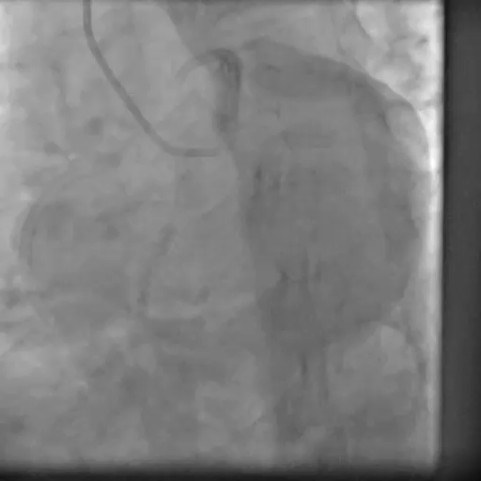
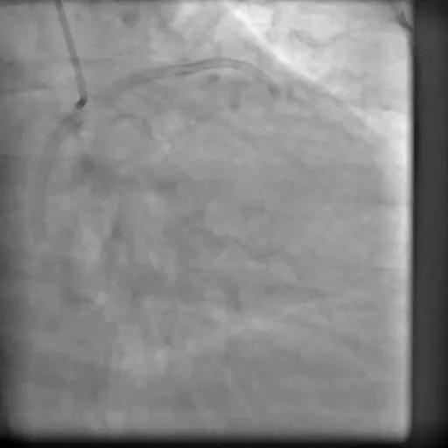
Pt taken up for CAG: LCX Ostial stent ISR with 90% stenosis, LAD mild ISR with under-expanded stent and D1 100% (prior disease): Probably LCX is the culprit

Slide 4
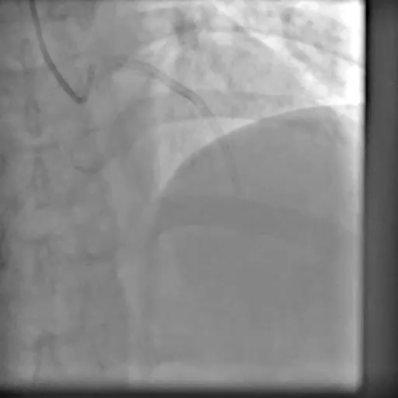
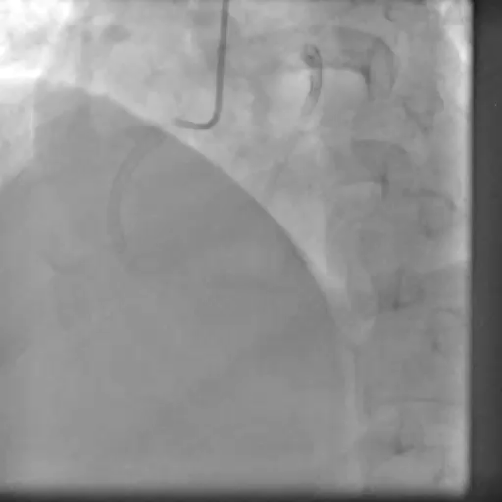
RCA mid stent ISR 30-50%, distal 50-70%
In view of repeat ISR within 6 months and non-availability of laser CABG was advised as patient might develop ISR again. But patient categorically denied.

Slide 5
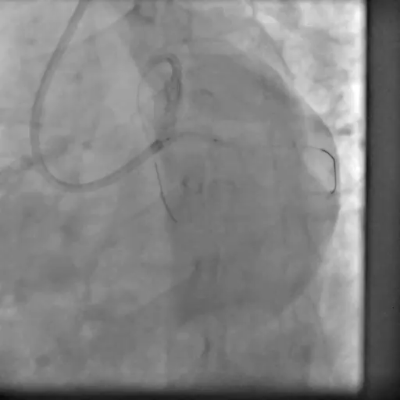
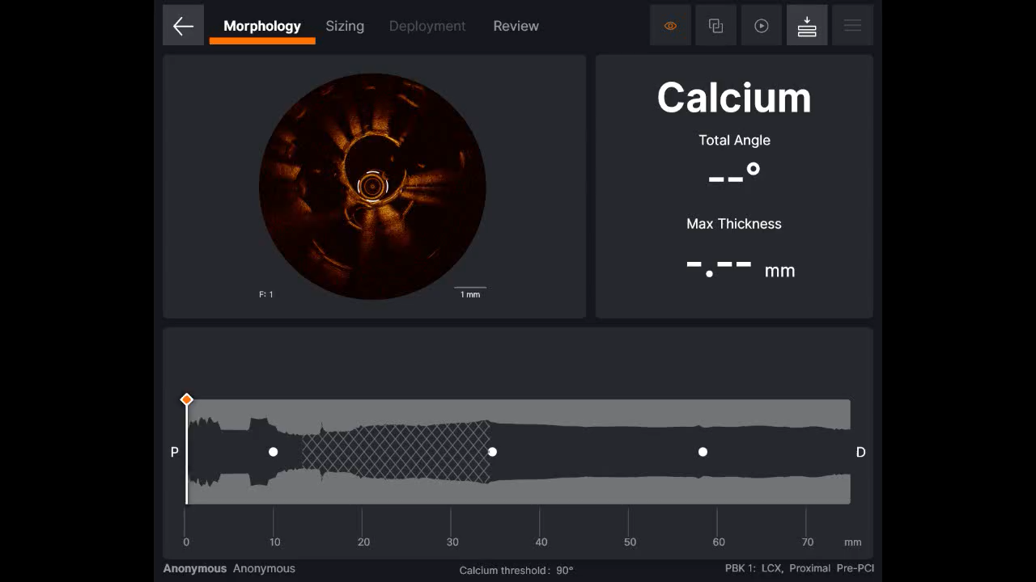

Next day Pt taken up for PCI with 7F femoral access, both vessels wired with fielder FC
Pre-PCI OCT LCX: underexpanded stent with in LAD and LCX with diffuse neointimal hyperplasia
Patient taken for OCT guided PCI, first LCX was pre-dilated with 2.5x12 mm balloon @12 atm

Slide 6
What next
Ostial LCX severe neointimal hyperplasia with undexpanded stent
Although angiographically, LAD showed no significant visible ISR, OCT showed diffuse neointimal hyperplasia with underexpanmded stent
Already 2 layers of stent in LAD
So we decided to go for LAD/LCX bifurcation PCI using pure DEB, Stent to be used only for rescue

Slide 7
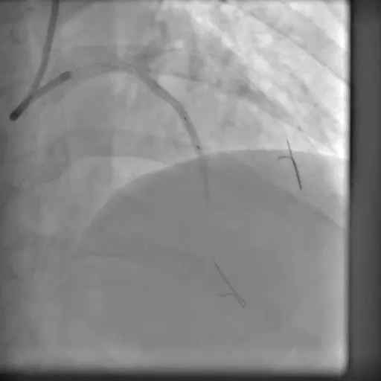
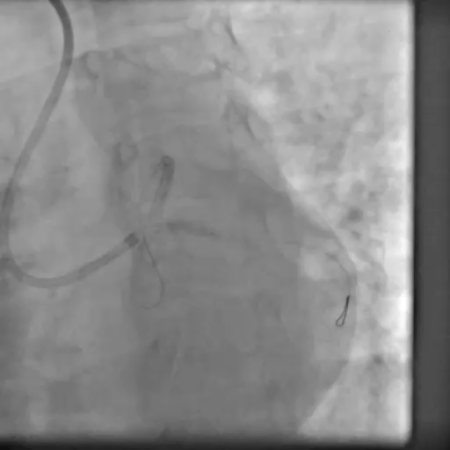
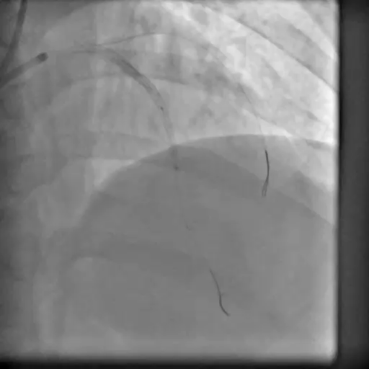
Lesion in LCX dilated with 3.0x10 cutting balloon @12 atm f/b 3.0x12 NC balloon @20 atm, LAD stent dilated with 2.5x 12 mm NC balloon @ 18 atm
2.5X20 mm DEB deployed in distal LAD @ 16 atm

Slide 8
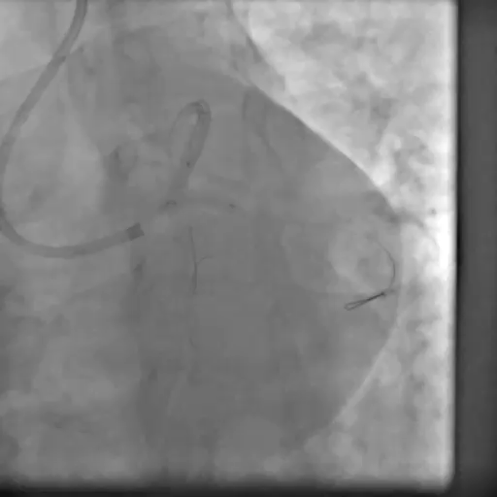
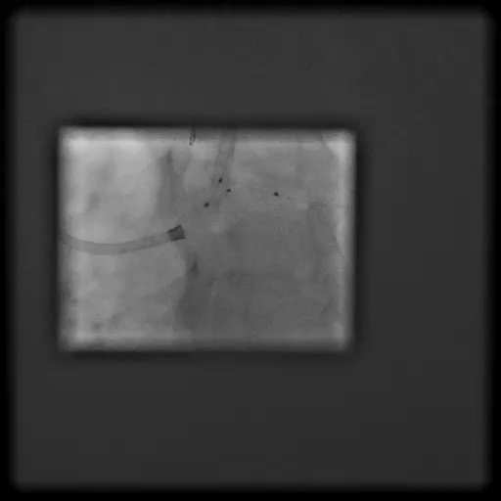
Kissing balloon dilation in LCX(3.0X15 mm) and LAD (3.0x12 mm) @ 12 atm
Modified POT 3.5x8 mm balloon @16 atm

Slide 9
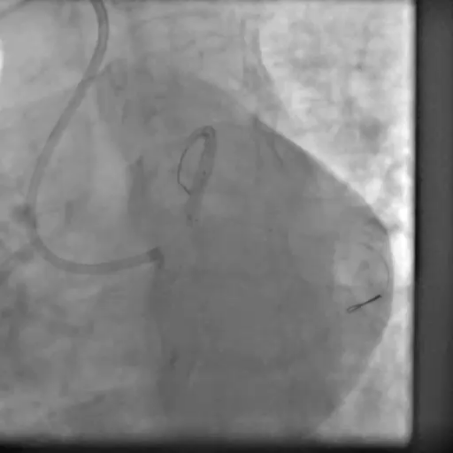
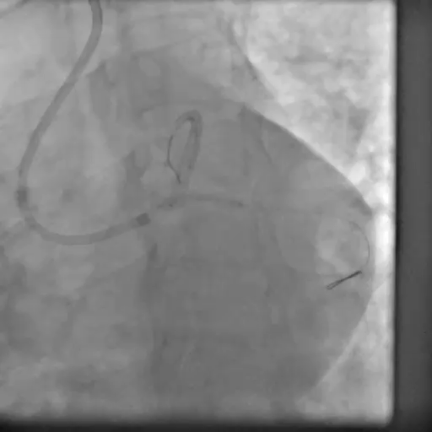
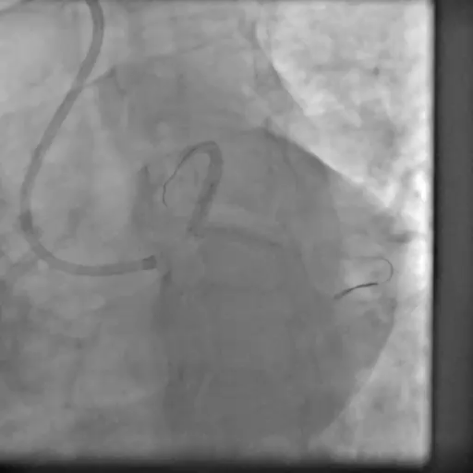
3x17 mm DEB deployed in LCX sequentially
FKBI done with DEB @ 12 atm
3X14 mm DEB deployed in LAD @ 16 atm

Slide 10
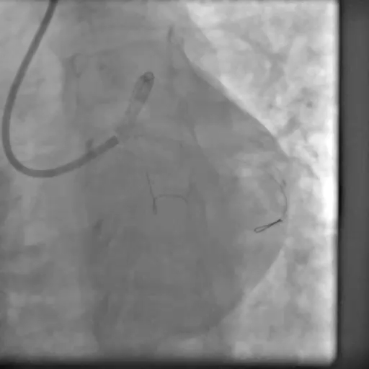
POST PCI OCT
LCX
LAD
Notes:
POST PCI MLA : LAD prox 9.10 mm2, distal 5.93 mm2, LCX 4.5 MM2, no major dissection with fair luminal area, so we left at this point.

