Slide 1
Catheter Closure of TRIPLE WHAMMY Circular Shunt in a young infant : A Curious Case
Dr Sowmya Kasturi
Consultant Pediatric Cardiologist
Sri Padmavathi Children’s Heart Centre
Tirupathi, Andhra Pradesh

Slide 2
HISTORY
1month old baby
Cyanosis at 1week of life
Echo :
D-TRANSPOSED GREAT ARTERIES
LARGE INLET VSD WITH MUSCULAR EXTENSION
GRADE I STRADDLING OF TV MODERATE OS ASD WITH BIDIRECTIONAL SHUNT
SMALLISH TV/HYPOPLASTIC RV

Slide 3
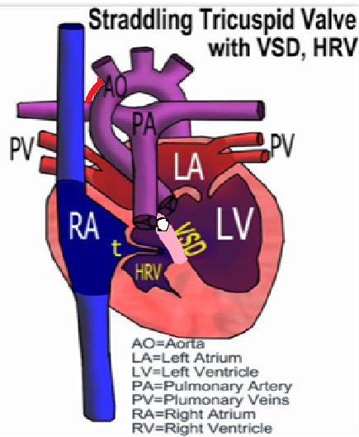
SURGERY
ARTERIAL SWITCH SURGERY + FENESTRATED VSD CLOSURE
ASD was left
Shifted to ICU
Had significant desaturation due to R-L shunt across the ASD
And Reduced Pulmonary Blood Flow
BAILED OUT with a 4mm RIGHT MODIFIED BT SHUNT

Slide 4
POST OPERATIVE COURSE
Stormy
Age : 2months
Weight : 2.2kgs
TV : z : -1.5
RV : Hypoplastic
PA pressure : High
PVR : High
Sepsis : High
CONUNDRUM OF
SMALLS and
BIGS

Slide 5
POST OP ctnd
Stayed in the hospital for 20days
Had infective pericardial effusion
Discharged with saturation of 80%
Mild tachypnea

Slide 6
Follow up at 3months
H/o episodes of LOC
O/E :
Irritability
Cyanosis
Tachypnea
Respiratory distress
PACKAGE OF EXTREMES

Slide 7
S/P ARTERIAL SWITCH + RT BT SHUNT
Residual VSD with Direct GERBODE defect
Moderate OS ASD R-L shunt
Dilated RA
Reduced BT shunt flows

Slide 8
TRIPLE CIRCULAR SHUNT : WASTED CIRCULATION
SYSTEMIC VENOUS RETURN
RIGHT ATRIUM
R-L SHUNT AT ASD
LEFT ATRIUM
HYPOPLASTIC RIGHT VENTRICLE
GERBODE DEFECT
LEFT VENTRICLE
PULMONARY ARTERY
AORTA
BT SHUNT

Slide 9
CATHETER CLOSURE OF THE TRIPLE SHUNT
BT SHUNT WAS BALLOON DILATED WITH A 3.5x20 mm CORONARY BALLOON

Slide 10
VSD DEVICE CLOSURE
VSD was crossed from RA-LV
A 6Fr RCA guide catheter was passed and parked in LV
An 8x6mm MFO device was deployed across the defect
Child went into COMPLETE HEART BLOCK

Slide 11
VSD DEVICE CLOSURE
The device was changed to a softer ADO II 6x4mm
After deployment and release child was with stable hemodynamics

Slide 12
6months Post Device Followup
Good weight gain
Asymptomatic child
No cyanosis
ECHO :
Device in good position
No residual shunt
No TR
Moderate ASD L-R shunt
TV annulus : 13mm , z score : -1.2
Good biventricular function

Slide 13
LEARNING POINTS
Complex CHDs require thorough understanding of anatomy, pathology and hemodynamics
Staged palliations should be considered in small and sick children
Team approach is essential for wholesome success of the patient

