Slide 1
SUCCESSFUL TEVAR IN A 28YEAR OLD FEMALE THROUGH HYBRID APPROACH
Dr Sowmya Kasturi,
Associate Professor,
Department of Pediatric Cardiology,
Sri Padmavthi Children’s Heart Centre,
Tirupathi, India.

Slide 2
HISTORY AND PHYSICAL EX
28yrs female, mother of 3, LCB : 9months
Occassional chest and back pain : 6months
C/O DOE : Class II-III : 5months
Episode of syncope : 20days ago
Stable vitals, BP: 110/76 all 4 limbs
Unremarkable auscultatory findings
Notes:
Wt : 55, Ht : 160cms

Slide 3
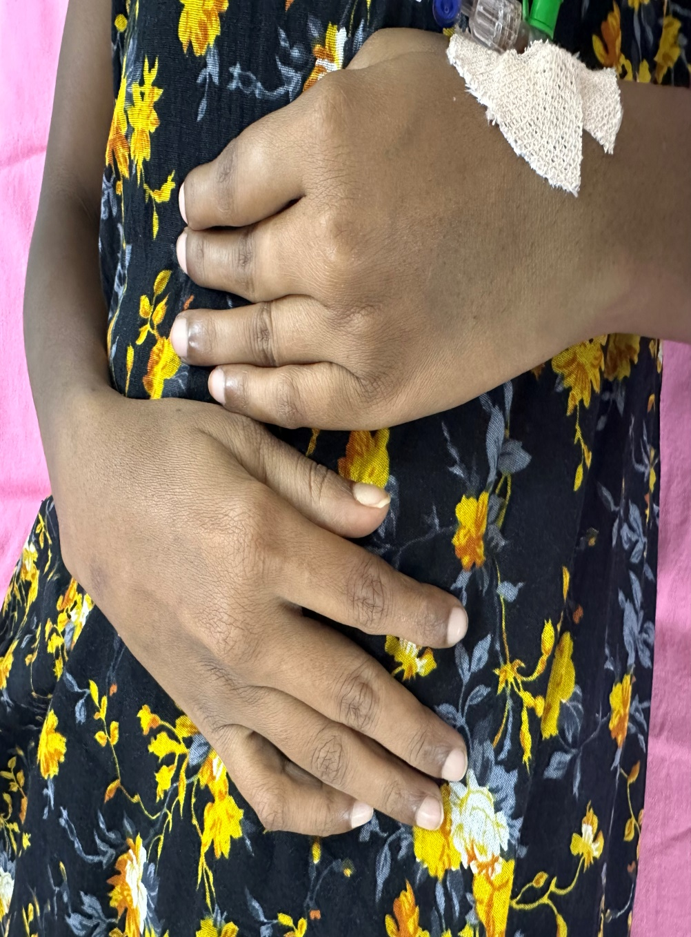

Slide 4
DIAGNOSIS
AORTIC DISSECTION : DEBAKEY III, STANFORD B
RUPTURED WITH CONTAINED THROMBUS
COMPLETE OCCLUSION OF TRUE LUMEN IN DTA
CELIAC, LEFT RENAL : FALSE LUMEN
SMA, RIGHT RENAL : TRUE LUMEN
MODERATE LV DYSFUNCTION, MILD MR, NO AR

Slide 5
FORMULATING A COMPREHENSIVE MANAGEMENT PLAN
HYBRID
ARCH VESSEL DEBRANCHING
CONDUIT FROM ASC AO AS ACCESS
SMALLER INCISION
NO CPB
SURGICAL APPROACH
EXTENSIVE INCISION
LONG BYPASS GRAFT
DEBRANCHING OF ARCH AND ABDOMINAL VESSELS
LONG CPB TIME
LV DYSFUNCTION
INTERVENTIONAL APPROACH
ACCESS : SMALL FEMORAL VESSELS
ANEURYSM CLOSE TO LSCA
COMPLETE ABSENCE OF TRUE LUMEN IN DTA
FEW ARTERIES FROM FALSE LUMEN
LONG STENT GRAFT

Slide 6
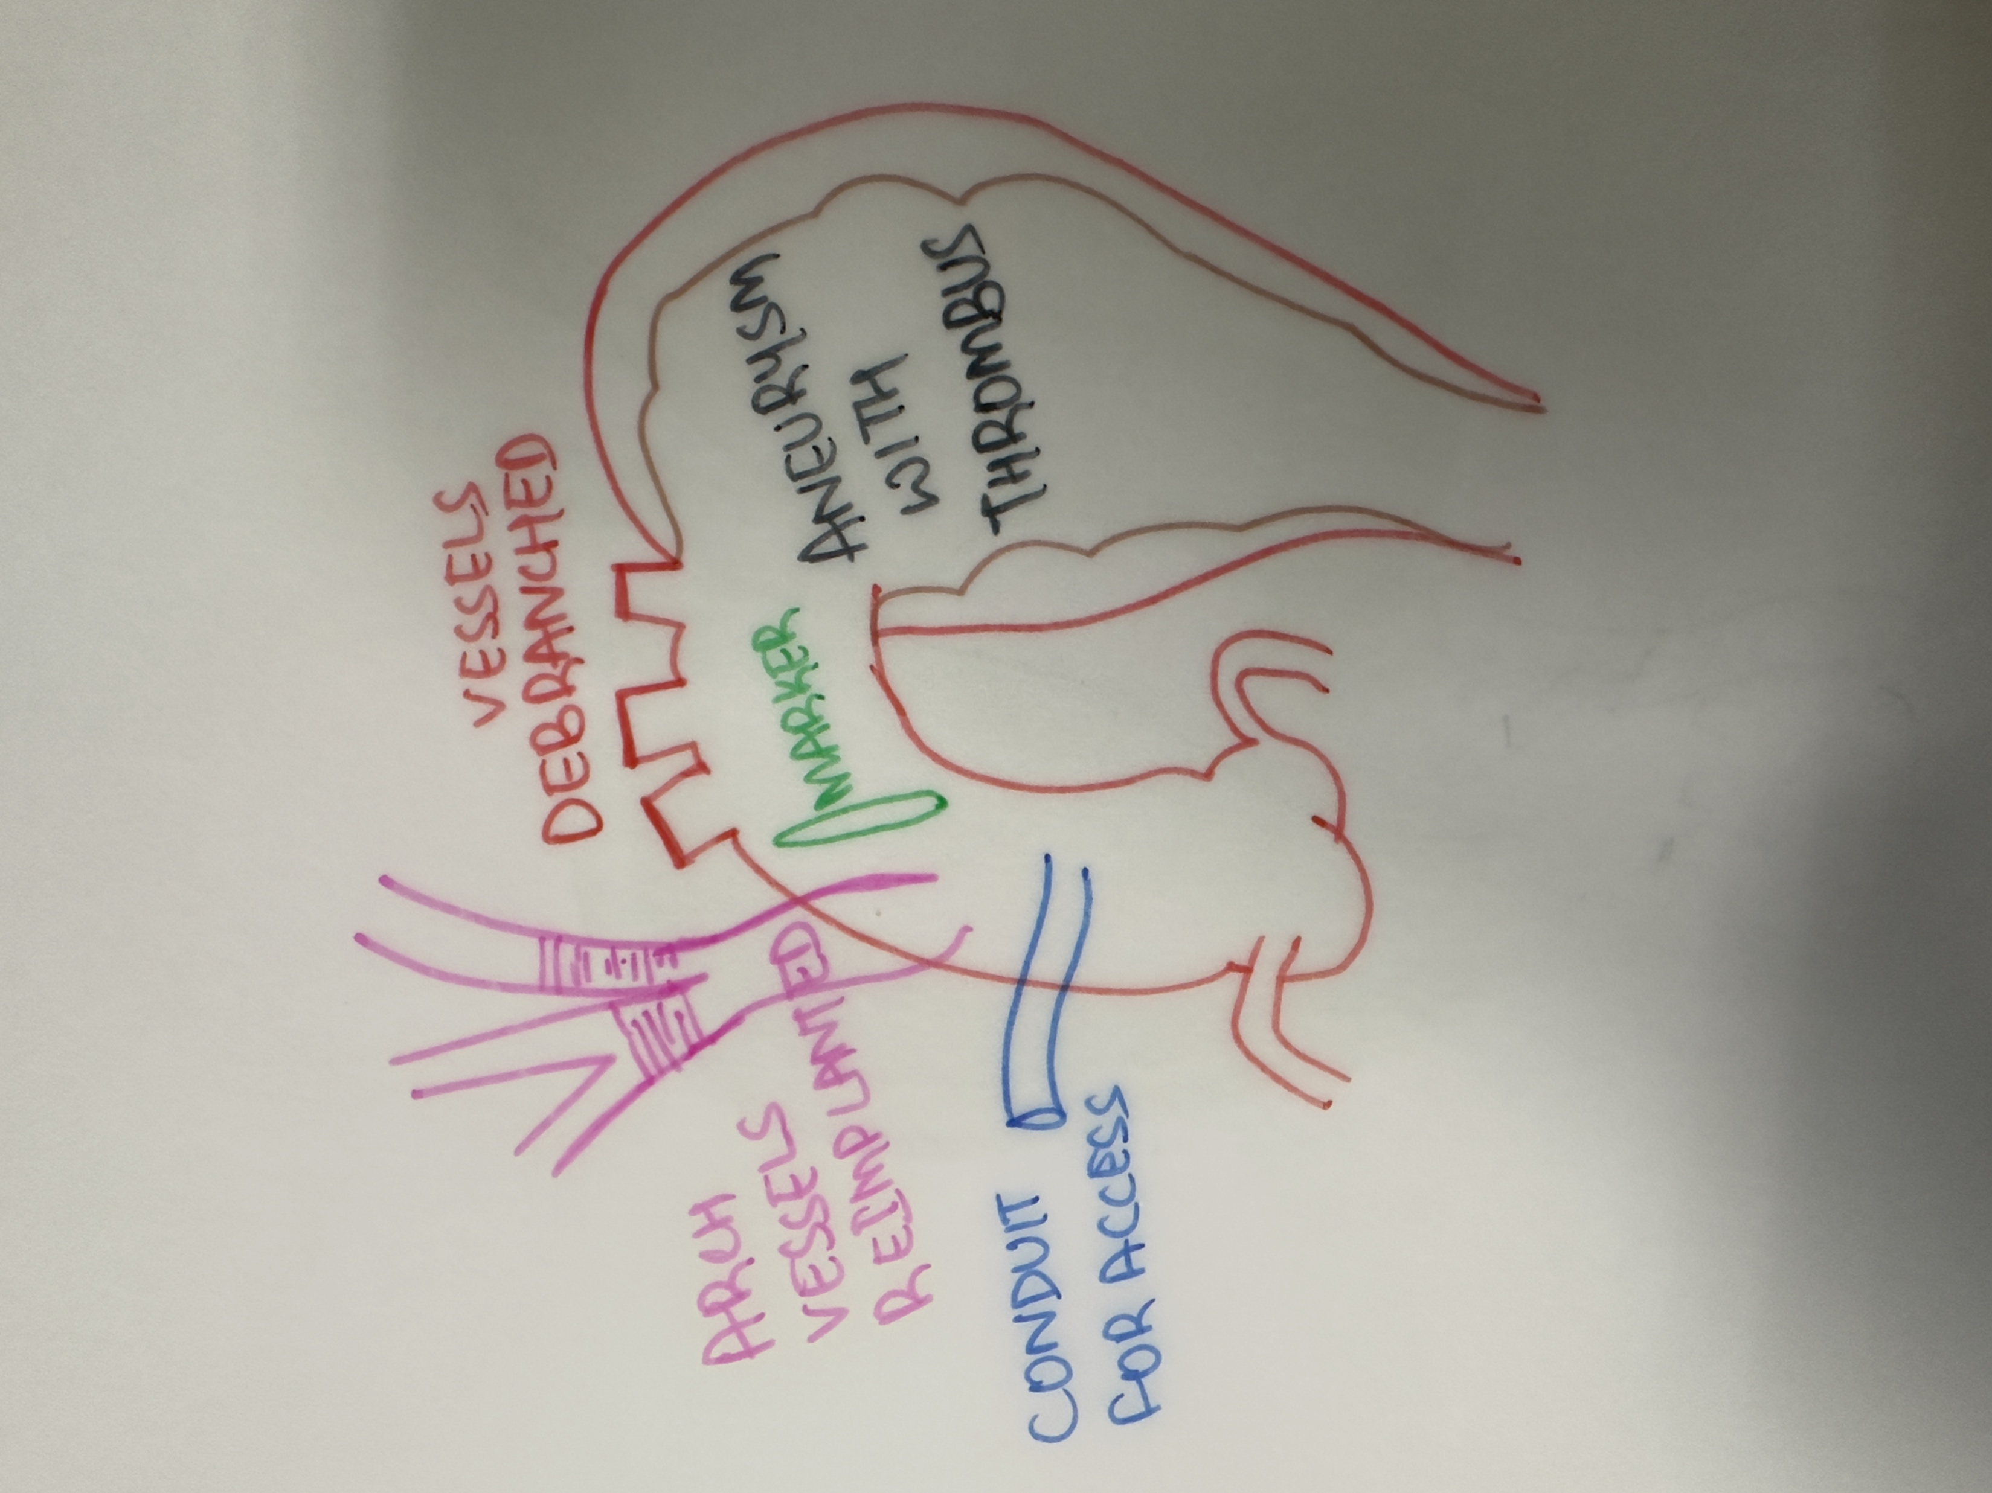
THE HYBRID STYLE
Under GA
Mini sternotomy
Debranching of LCCA and Innominate artery to ascending aorta
Exteriorization from ascending aorta with a conduit which serves as an access
Both femoral arteries
Pigtail angiogram through conduit shows implanted vessels and large aneurysm of arch

Slide 7
Abd aortic angiogram showing complete occlusion of supra renal aorta
Attempts to enter the true lumen with straight tip glide wire

Slide 8
Wire passed from true-false-true lumen which was snared from asc aorta
Balloon dilatation of track to facilitate passage of stent graft system

Slide 9
Passage of stent graft (28x24x200) over the snared stiff wire
Balloon dilatation of proximal stent graft as the expansion was inadequate

Slide 10
Jumping of the stent graft during removal of nose cone
Pigtail angiogram showed patent aneurysm with residual filling

Slide 11
Advancement of second stent (30x30x200) graft
Ascending aortic angiogram showed complete occlusion of aneurysm with no significant residual

Slide 12
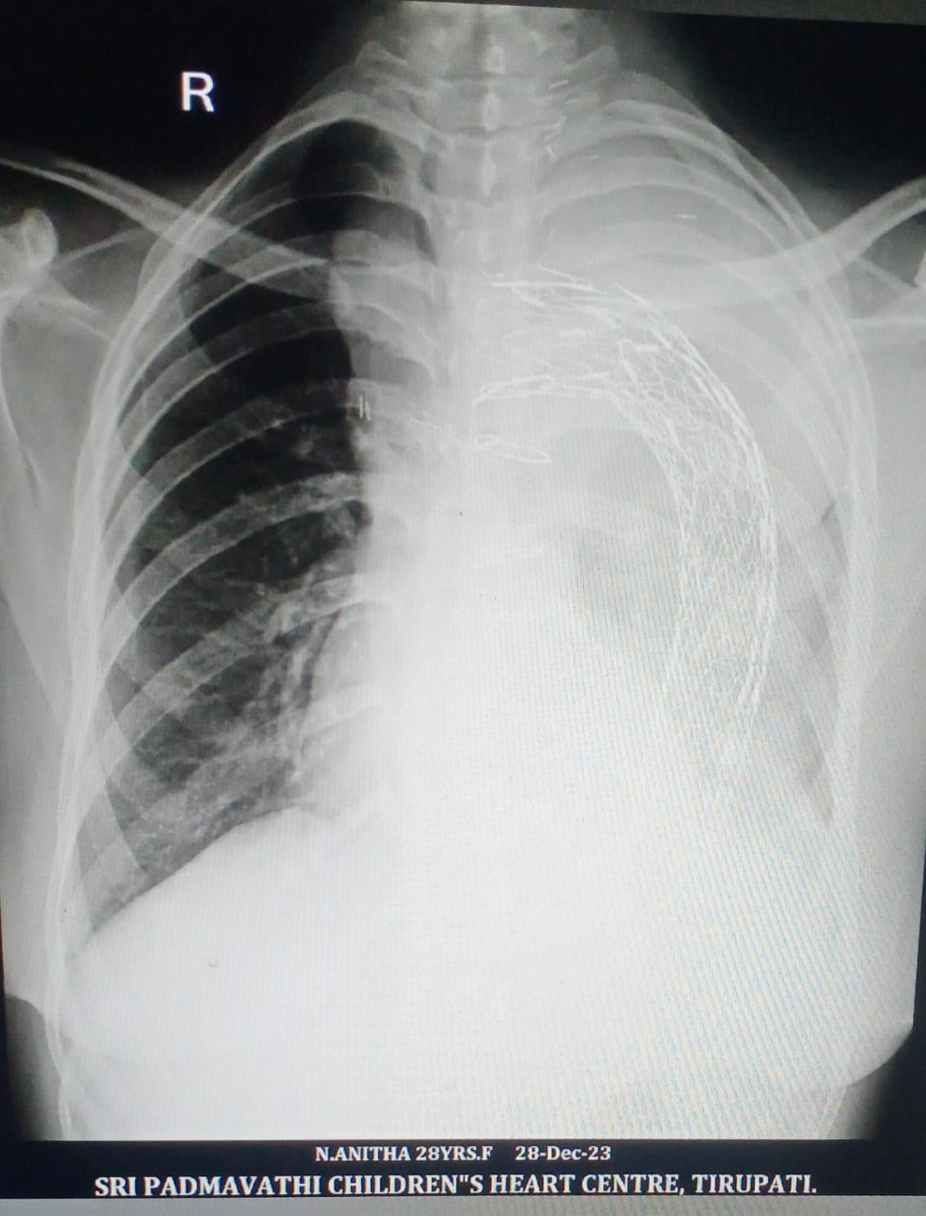
POST OP COURSE
Asc aortic conduit was ligated and put back in subcutaneous tissue
Patient was extubated after 12hours
Uneventful post op period
Was started on dual antiplatelets
Discharged on day 7

Slide 13
LEARNING POINTS
Complete anatomical understanding of the lesion is absolutely essential in complex interventions
Hybrid approach can provide the best of two conventional methods
Team work always wins

